Slide 1
Imagine Design Workshop
Plan to Produce | P2P-WS021/I2D-WS059
Manufacturing Execution I in SAP (Packaged) Process Orders & EWM Production Integration
18/06/2025

Slide 2
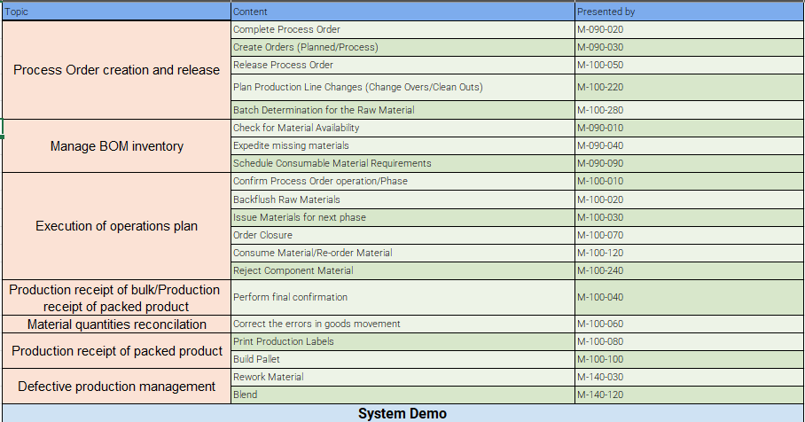
Agenda

Slide 3
Workshop Goals after agenda
We would expect the following outputs and deliverables coming from the workshops:
# | Workshop Topics | Output | Location links / format
1 | Review process design | Update Celonis process model Fiori apps (Executables) Swim lanes w/ roles in process model | L3 Sub-Process in Celonis L4 Process Steps in Celonis
2 | Key design decisions | Create KDD | KDD log in Jira + KDD Template in Google Drive
3 | Fit/Gap analysis | List of Fits/Gaps identified | Fit & Gap Identification in Jira Build Backlog Gap template
4 | Functional Integration considerations | Create KDD for Integrations | KDD log in Jira KDD Template in Google Drive

Slide 4

Workshop Agenda
Manufacturing Execution in SAP Packaged Process Orders and EWM Production Integration
Process Order creation and release
Staging for production with EWM
Manage BOM inventory
Execution of operations plan
Production receipt of bulk/Production receipt of packed product
Material quantities reconciliation
Production receipt of packed product
Defective production management
System Demo

Slide 5
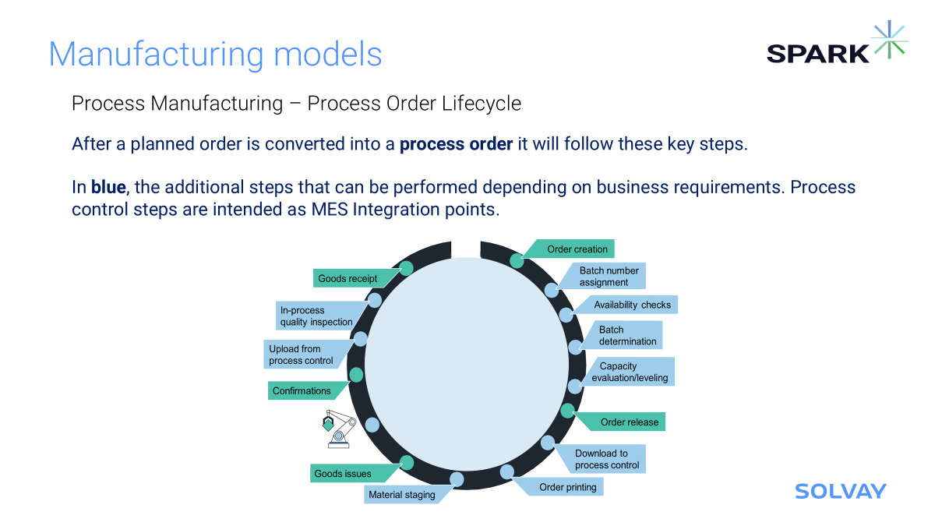
Workshop Agenda
Manufacturing Execution in SAP Packaged Process Orders and EWM Production Integration
Process Order creation and release
Manage BOM inventory
Execution of operations plan
Production receipt of bulk/Production receipt of packed product
Material quantities reconciliation
Production receipt of packed product
Defective production management
System Demo

Slide 6
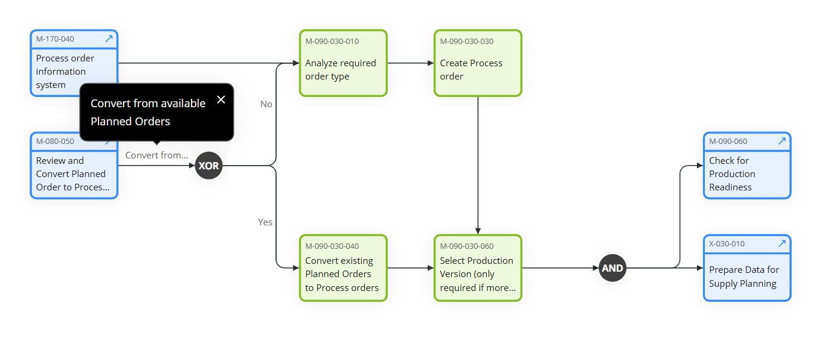
Create Process Orders - M-090-030
This process involves generating process orders based on production plans and schedules. A process order specifies the details of the production job, including materials, resources, and timelines required to produce a specific quantity of products.

Slide 7
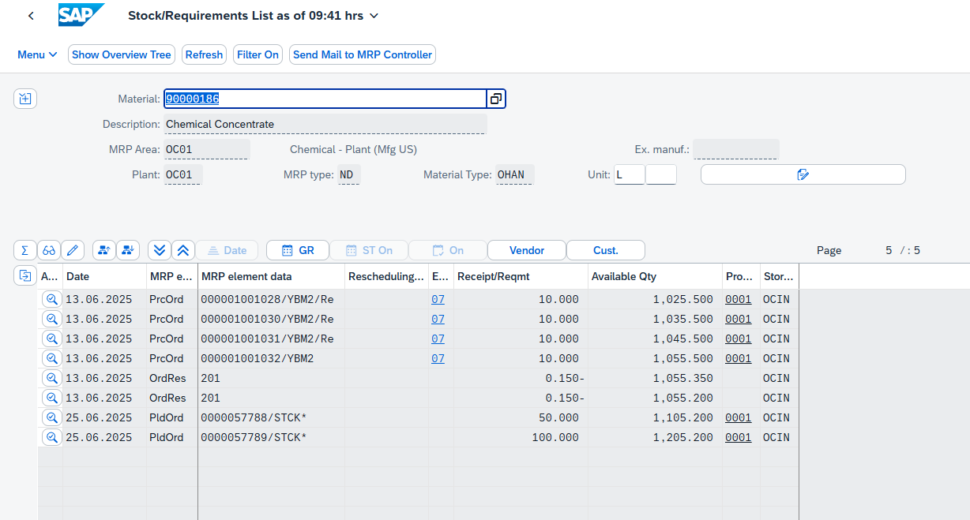
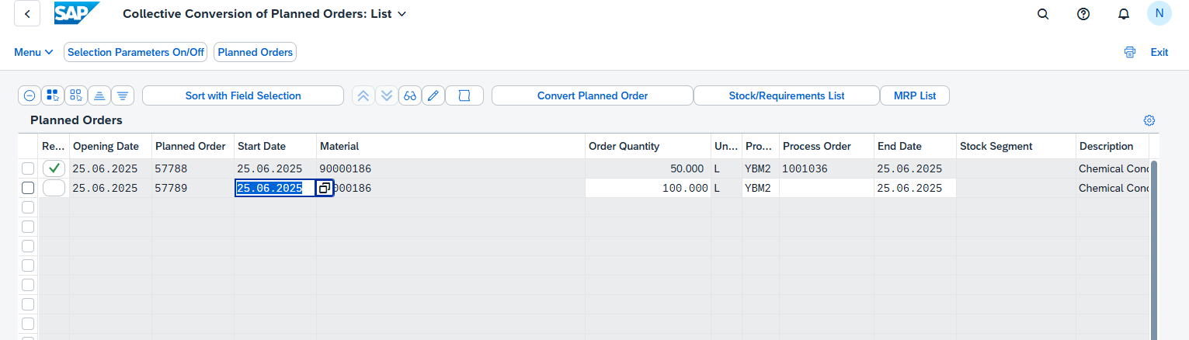

Process Orders - Creation (Planned order to Process order)
Planned orders are converted to process orders in SAP PP-PI to initiate detailed scheduling, resource allocation, and shop floor execution.
This conversion enables material availability checks, batch management, and real-time production tracking.

Slide 8
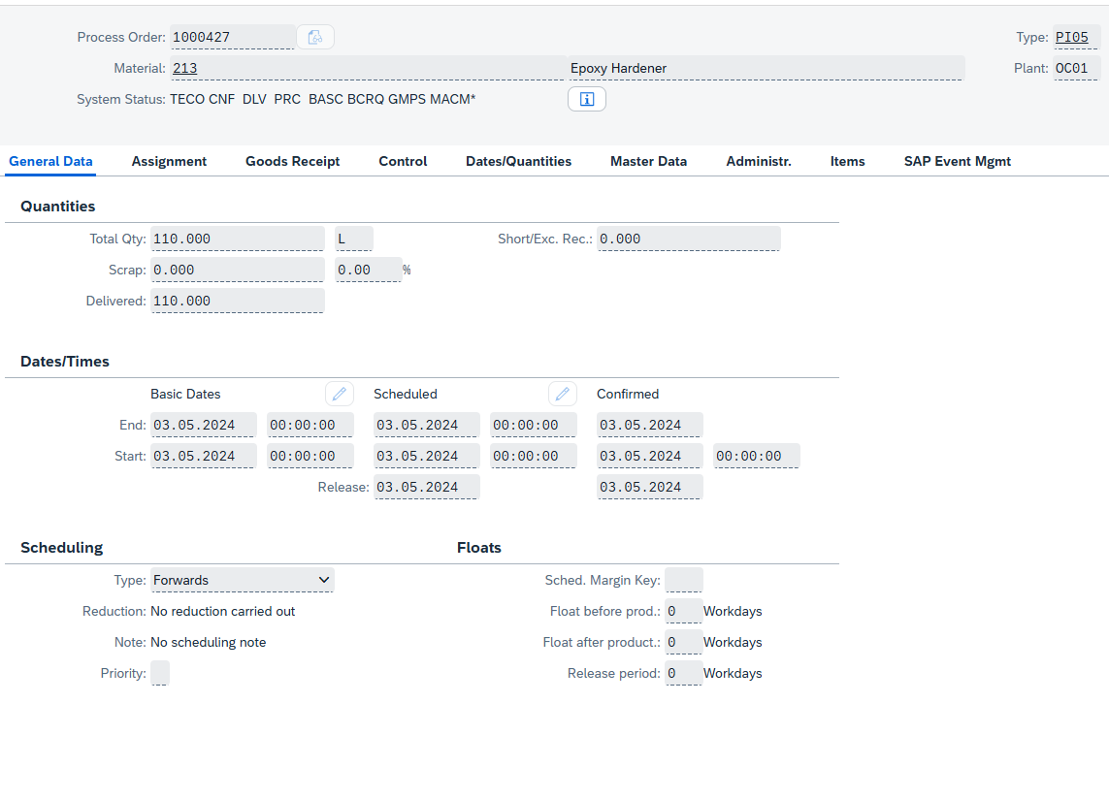
Process Orders - Creation
System Status: Key displaying the current status of the process order
Order Type: Key differentiating orders according to their use.
Total Quantity: The quantity of the process order.
Dates & Scheduling: Based on the scheduling type, the end and start date of the process order are determined.
Scheduling Margin Key for Floats: Key that the system uses to determine the floats required for scheduling an order.

Slide 9
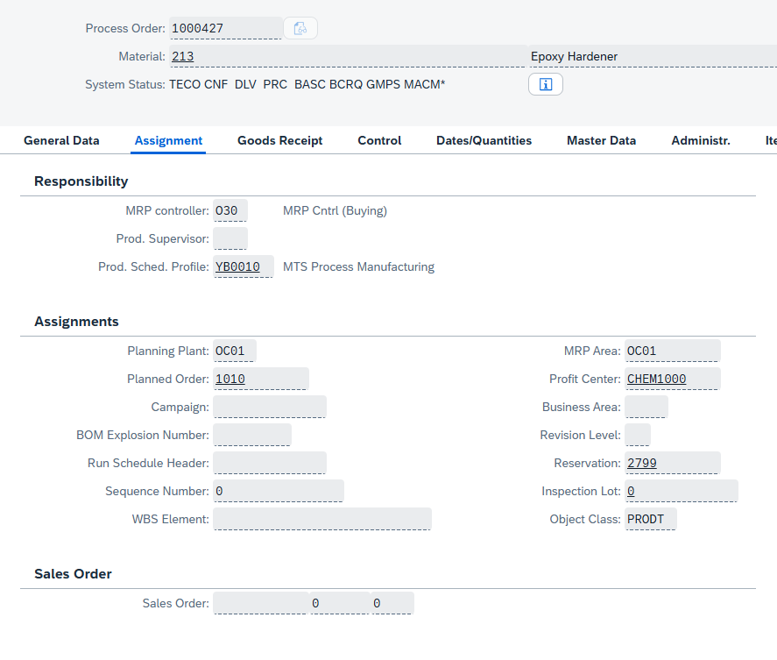
Process Orders - Creation
MRP Controller: Number of the responsible MRP controller
Production Scheduling Profile: Profile that you can use to
specify that certain business transactions are carried out in parallel in a production order / process order (you can, for example, create and release an order at the same time, or release an order and print the shop papers)
trigger an automatic goods receipt
specify an overall profile for capacity leveling
Assignments:
The most important assignments are the planned order and the sales order. This happens automatically.

Slide 10
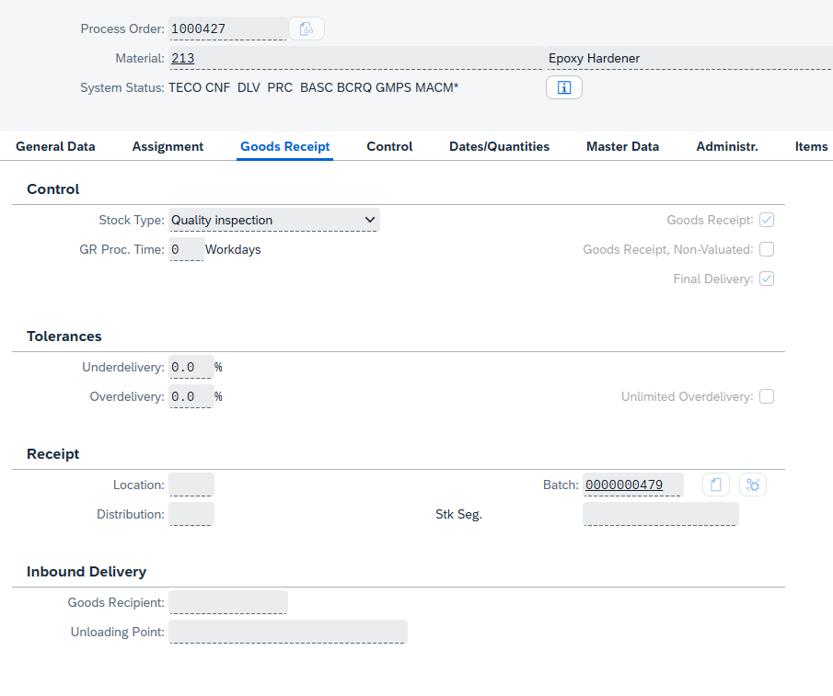
Process Orders - Creation
Stock Type: Specifies the stock to which the material is posted upon goods receipt (or from which it is posted upon goods issue).
Batch: Assigns the production to that particular batch.

Slide 11
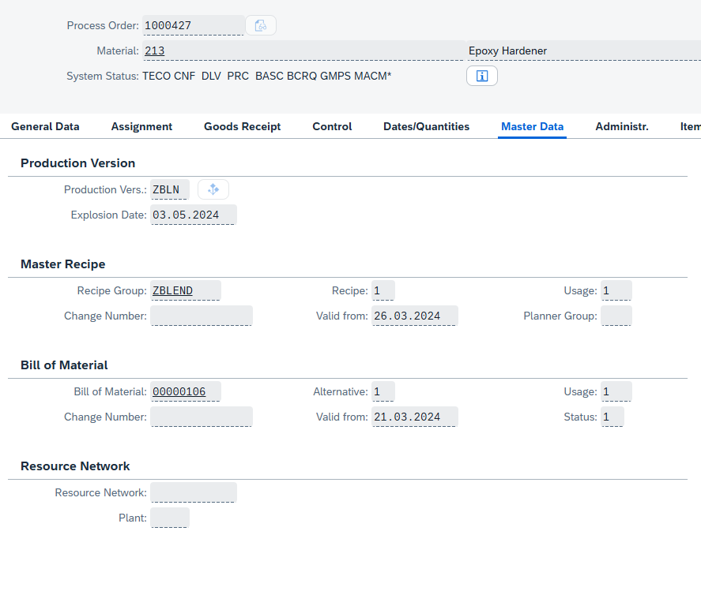
Process Orders - Creation
The Master Data View indicates the production version, master recipe, bill of material, and, if present, the resource network that are assigned to the process order.

Slide 12
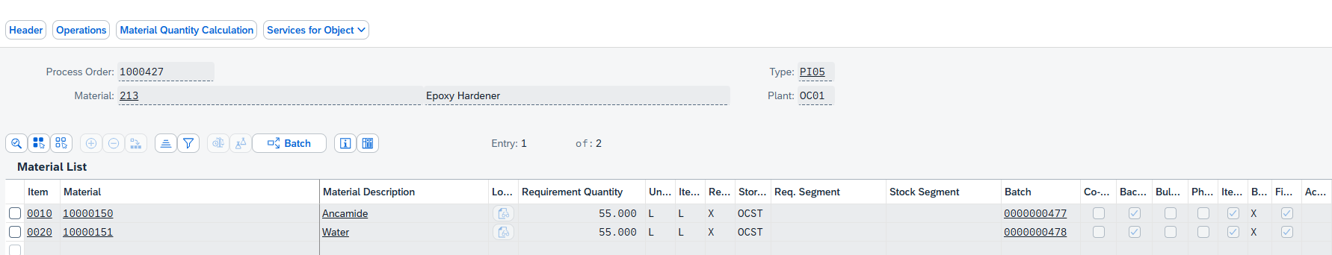
Process Orders - Creation
The material list includes all the materials that will be used during the production process.

Slide 13
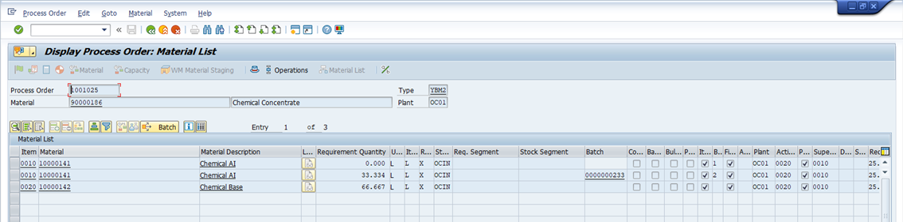
Process Orders - Creation
Batch determination in SAP PP is the automated selection of the right batch of material during production, based on predefined criteria like expiration date or quality. This ensures traceability, quality control, and regulatory compliance by making sure the correct materials are used in each production process.

Slide 14
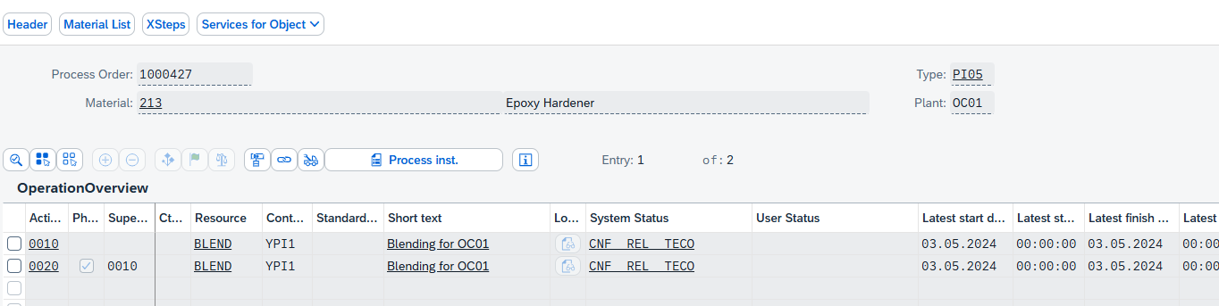
Process Orders - Creation
The operations include all the activities and phases that will be executed during the production process.
Phases are the main steps in the process order.
Activities are the tasks or resource usages within each phase.
Each phase can have multiple activities assigned to it.

Slide 15
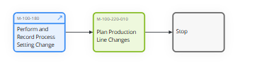
Plan Production Line Changes (Change Overs/Clean Outs)- M-100-220
In SAP PP, planning production line changes involves updating the production plan to reflect new products, processes, or schedules. This typically includes modifying the bill of materials (BOM) and recipe, adjusting production versions, and updating master data. The changes are then incorporated into the production schedule, ensuring that future orders use the revised setup.

Slide 16
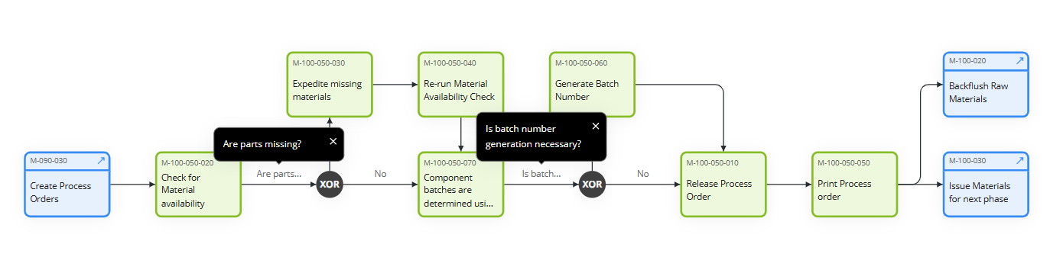
Release Process Order - M-100-050
This process involves authorizing a process order to begin production. It involves several steps and checks to ensure that all necessary prerequisites are met before production can begin. This includes checking material availability, capacity, and ensuring that all required documents and approvals are in place

Slide 17
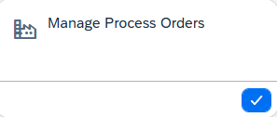
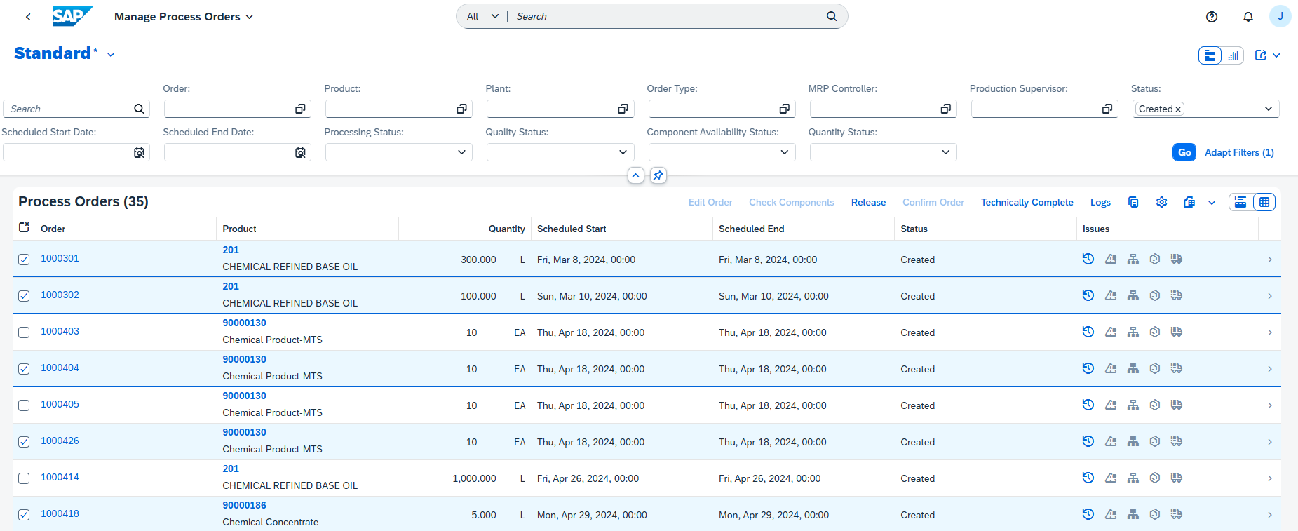
Process Orders - Release

Slide 18
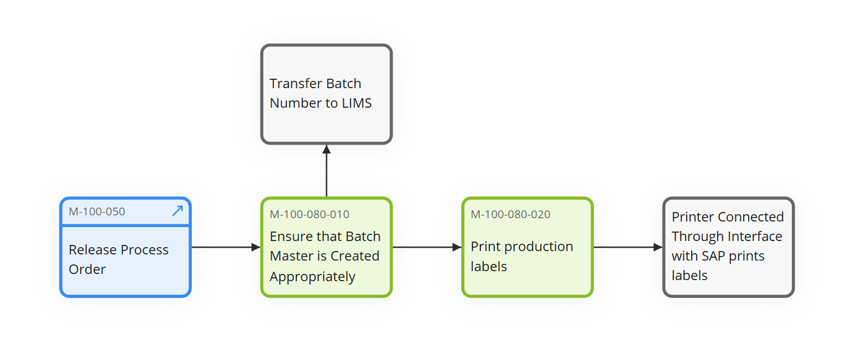
Print Production Labels - M-100-080
This process involves printing labels for products or materials used in production. Forms and labels are essential for various business transactions, including order confirmations, delivery notes, and production labels. Labels typically include information such as product codes, batch numbers, and quantities, ensuring proper identification and traceability.

Slide 19

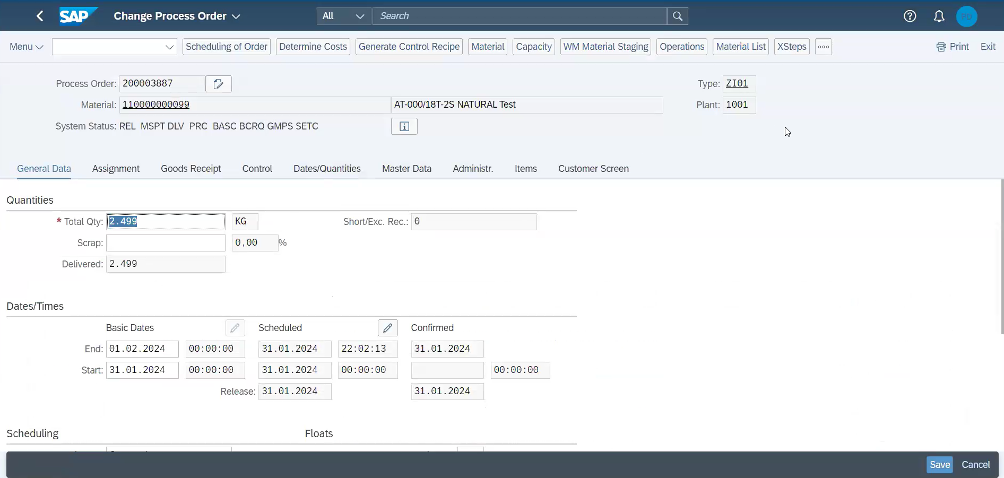
Print Shopfloor Forms via Change Process Order App
Process Orders can be printed via COR2 or Change Process Order App

Slide 20
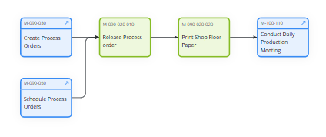
Complete Process Order - M-090-020
The process order workflow ensures seamless transition from order creation to execution, facilitating efficient production management and communication.
Key steps include creating, scheduling, and releasing orders, followed by printing shop floor papers and conducting daily production meetings for alignment.

Slide 21
Workshop Agenda
Manufacturing Execution in SAP Packaged Process Orders and EWM Production Integration
Process Order creation and release
Staging for production with EWM
Manage BOM inventory
Execution of operations plan
Production receipt of bulk/Production receipt of packed product
Material quantities reconciliation
Production receipt of packed product
Defective production management
System Demo

Slide 22
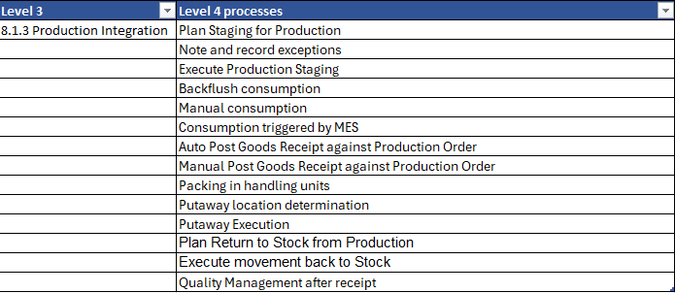
Objective of the Session
Approach for the workshop:
Quick recap on P2P integration with EWM models (Process manufacturing)
End to End process flow including staging, consumption and production receipt
Detailed discussion on each L4’s
Master data objects : Production supply area, Control cycles, assignment of production supply area to warehouse bin
Bulk and Finished goods - Process manufacturing with EWM integration
Identify gaps in standard process

Slide 23
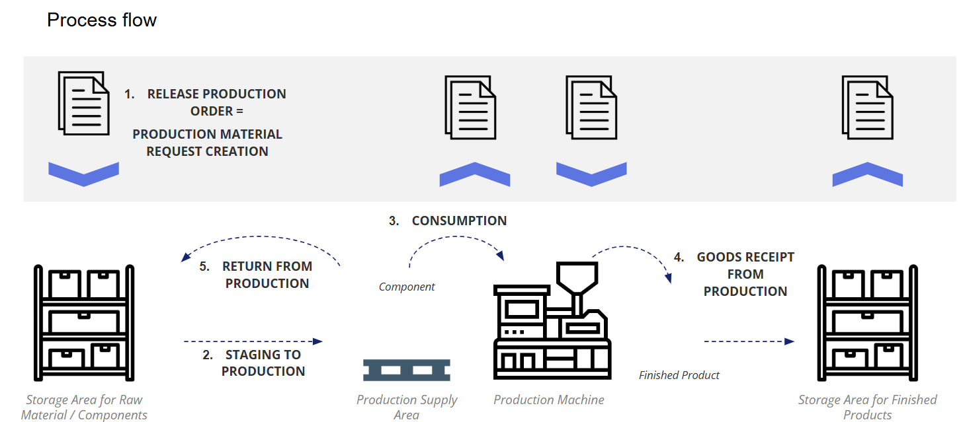
L3 Chemical Core Process Flow Diagram
Recap Process Order integration with EWM

Slide 24
Workshop Agenda
Product and Production Master Data
Staging for production

Slide 25
L3 Chemical Core Process Flow Diagram
Process Order integration with EWM
Staging for production
Automatic
Process order release
Staging Request to EWM
Production material request
Plan stage for production
Execute production staging
Note & record exceptions
Stock moved to PSA

Slide 26
L3 Chemical Core Process Flow Diagram
Process Order integration with EWM
Staging for production
Automatic
Process order release
Staging Request to EWM
Production material request
Plan stage for production
Execute production staging
Note & record exceptions
Stock moved to PSA

Slide 27
L3 Chemical Core Process Flow Diagram
Process Order integration with EWM
Plan stage for production
Production material request
Execute staging for production manual or automatic(via BG job)
Staging warehouse order created
Stock movement rules, Batch selection(Cross)
Single order staging
Cross order staging
Validate Staging warehouse order
1.GT Single order is only in scope
Generate pick list
Execute production staging

Slide 28
L4 Documentation & Actions
FIT/GAPs:
N° | Fit/GAP | Description
1 | Single order | Single order staging
2 | Batch determination | Batch determination at production order(Single order can only be used)
Action:
N° | Description | Owner | Due Date | Next steps

Slide 29
Workshop Agenda
Manufacturing Execution in SAP Packaged Process Orders and EWM Production Integration
Process Order creation and release
Staging for production with EWM
Manage BOM inventory
Consumption for production with EWM
Execution of operations plan
Production receipt of bulk/Production receipt of packed product
Material quantities reconciliation
Production receipt of packed product
Defective production management
System Demo

Slide 30
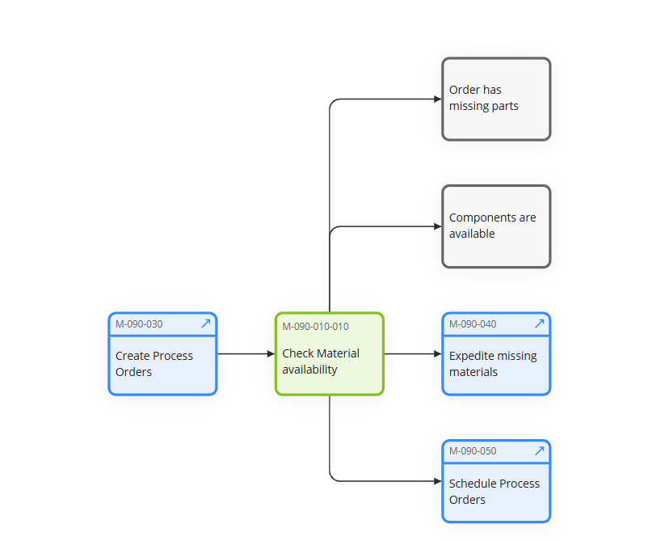
Check for Material Availability - M-090-010
A material availability check in a process order ensures that all required components and materials are available in the necessary quantities before production begins. This check is crucial for smooth production execution, preventing delays and disruptions caused by missing materials.

Slide 31



L3 – Check for Material Availability
Process
order
Controls the scope of check during the order processing.
The Scope of check: The checking rule, in conjunction with the checking group, determines the scope of the availability check for every business operation.
The following elements can be defined in the scope of availability check during order processing
  Stock
  Safety Stock
  Stock in Transfer
  Blocked Stock
  Quality Inspection
  Factors such as Replenishment lead time (RLT), Release Orders, Planned Orders etc.
Requirements
qty/date
Availability check:
Checks whether all the materials required to perform an operation or manufacture the product are/will be available
Check result
Confirmed quantity
Missing part record
Status MSPT (material shortage)
ATP Quantity
=
Warehouse stock + Inbound Quantity
-
Outward Quantity

Slide 32
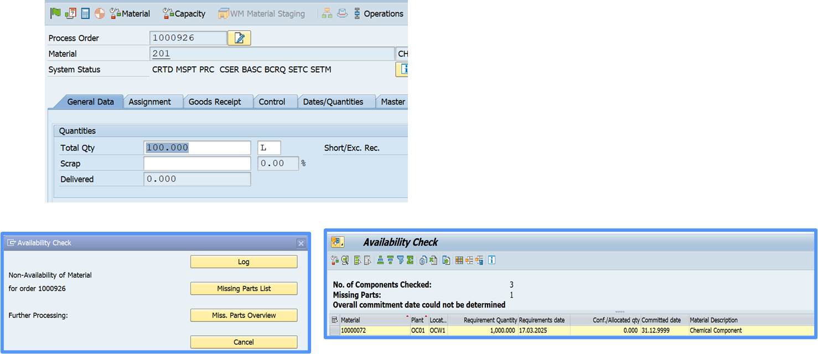
Process Orders: Material Availability Check
The material availability check is a critical process that verifies whether all necessary raw materials and components are available in inventory before releasing or executing a production or process order. This check helps identify any shortages early, allowing planners to resolve issues—such as ordering missing materials or rescheduling production—so that manufacturing can proceed smoothly without interruption

Slide 33
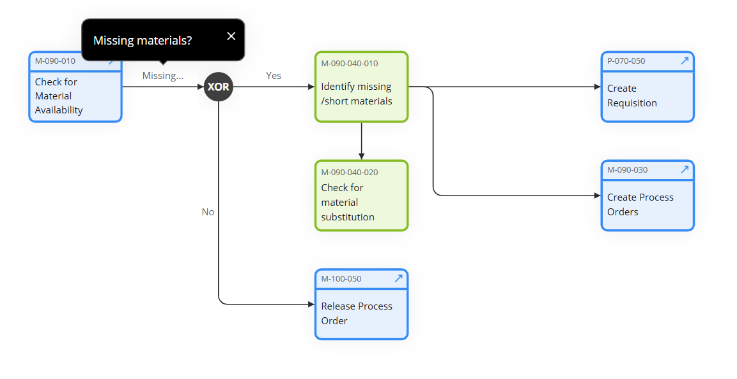
Expedite missing materials - M-090-040
This process involves taking actions to quickly obtain materials that are not available but are required for production. It includes activities such as expediting purchase orders, reallocating materials from other locations, or finding alternative suppliers.

Slide 34
Schedule Consumable Material Requirements - M-090-090
In SAP, consumable materials refer to items that are purchased for immediate consumption rather than for inventory or resale. These materials are typically used in operations, maintenance, or production processes and are not tracked as stock items after receipt. Examples include office supplies, lubricants, cleaning agents, and spare parts.
Key Characteristics of Consumable Materials:-
Not Managed in Inventory
Expensed at Receipt
No Material Master Needed (Optional)

Slide 35
Workshop Agenda
Manufacturing Execution in SAP Packaged Process Orders and EWM Production Integration
Process Order creation and release
Staging for production with EWM
Manage BOM inventory
Execution of operations plan
Production receipt of bulk/Production receipt of packed product
Material quantities reconciliation
Production receipt of packed product
Defective production management
System Demo

Slide 36
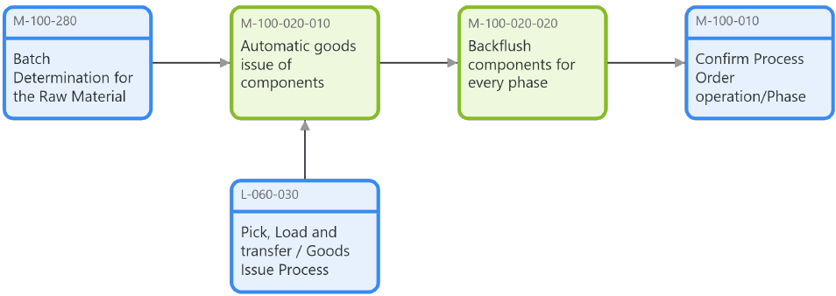
Backflush Raw Materials - M-100-020
This process involves backflushing, it is an automated process in SAP PP where raw materials are issued to a process order at the time of confirmation. This means that instead of manually issuing materials to the process order, the system automatically deducts the required quantities of materials from inventory based on the Bill of Materials (BOM) when the process order is confirmed.

Slide 37
Backflush Indicator Settings
The system checks the backflush indicator in the following order:
Material Master < Work Center < Recipe< Production/Process Order
If the indicator is set in the recipe, it takes precedence over the material master and work center settings for that specific recipe.
If the indicator is not set in the recipe, the system checks the material master and work center settings.

Slide 38

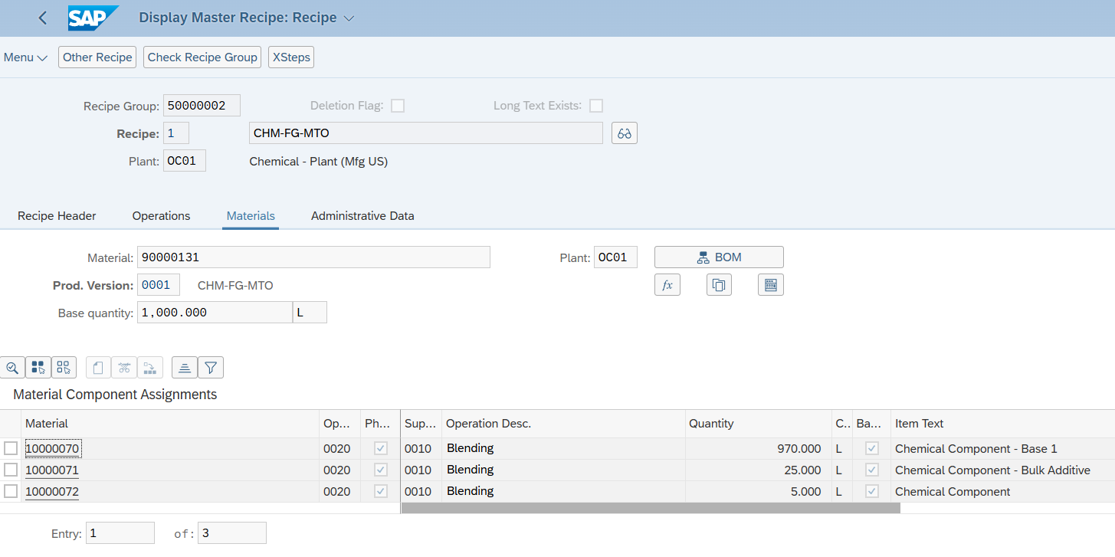
Illustration to maintain Backflush Indicator in Master Recipe

Slide 39
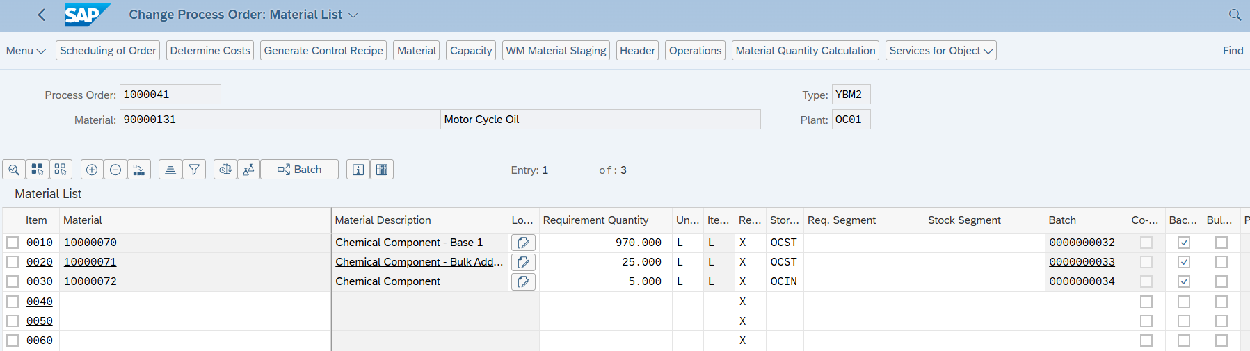
Illustration to maintain Backflush Indicator in Process Order

Slide 40
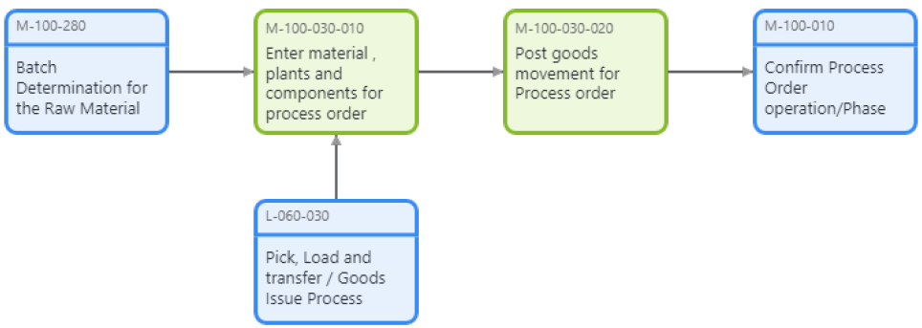
Issue Materials for Next Phase - M-100-030
This process involves issuing the required materials for the next phase of production i.e. making sure the required materials are available for the upcoming phase. This ensures that the production process can continue smoothly without interruptions due to material shortages.

Slide 41



Goods Issue of component for Order
Batch : 1
Mat. RAW1
Stor. Loc. 0001
It is defined as physical outbound movements of goods or materials from the warehouse. In SAP PP, goods issue takes place when the raw material is consumed to produce material as per Process order. When goods are issued, the system decreases the inventory of components at the storage location in the Production Planning system. Movement type 261 is used for goods issue.
Process:-
First, three raw material batches are consumed by the same process order. The good issue with movement type 261 is posted for each batch.
Goods Issue 1
Movement Type 261
Mat. Document 50000000195/2
Quantity 100.00 KG
Production Order
700011
GBT-FINISH1
Batch 2
Mat. RAW2
Stor. Loc. 0001
Goods Issue 2
Movement Type 261
Mat. Document 50000000195/3 Quantity 99.00 KG
Goods Issue 3
Batch 3
Mat. RAW3
Stor. Loc. 0001
Movement Type 261
Mat. Document 50000000195/4
Quantity 1.00 KG
Legend
Mat. - Material
Stor. Loc. - Storage Location

Slide 42
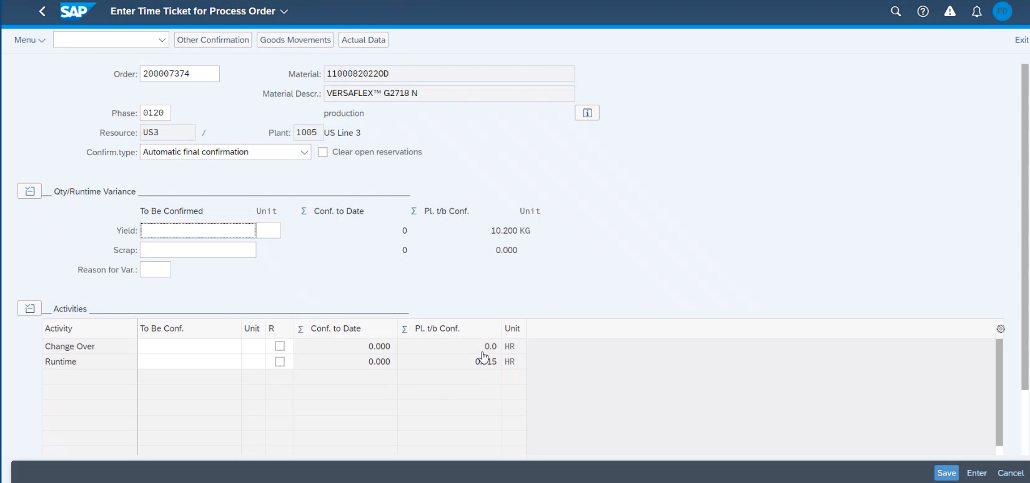
Illustration to Issue Materials via Confirm Process Order Phase App
Enter Order & Phase details & then click on Goods Movement

Slide 43
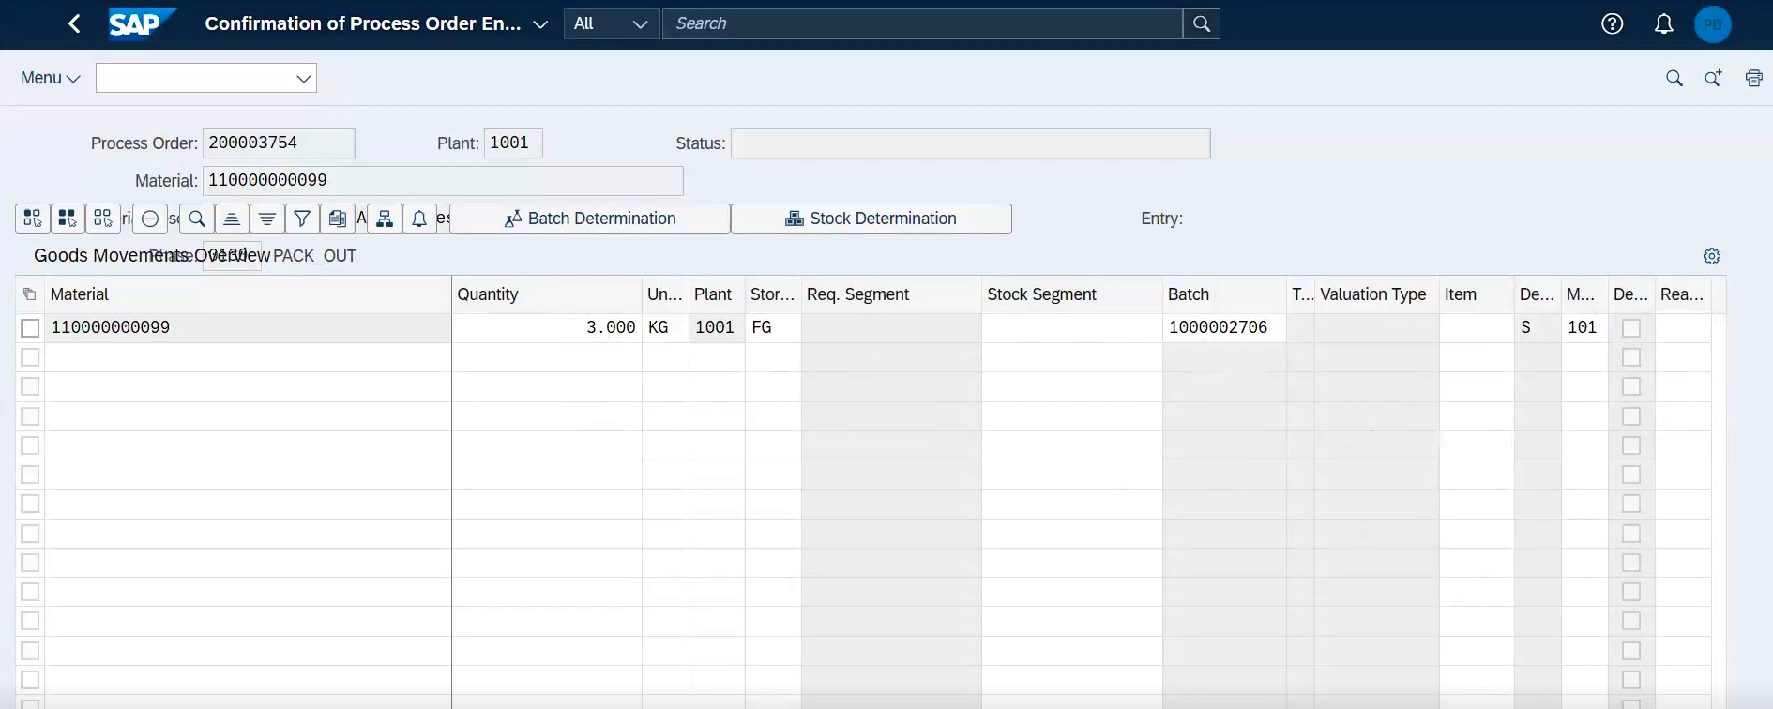
Illustration to Issue Materials via Confirm Process Order Phase App
Enter Material, Quantity, UoM, Batch & other details to Issue Materials to the Operation/ Phase

Slide 44
Workshop Agenda
Manufacturing Execution in SAP Packaged Process Orders and EWM Production Integration
Process Order creation and release
Staging for production with EWM
Manage BOM inventory
Consumption for production with EWM
Execution of operations plan
Production receipt of bulk/Production receipt of packed product
Material quantities reconciliation
Production receipt of packed product
Defective production management
System Demo

Slide 45
Objective of the Session
Approach for the workshop:
Quick recap on P2P integration with EWM models (Process manufacturing)
End to End process flow including staging, consumption and production receipt
Detailed discussion on each L4’s
Master data objects : Production supply area, Control cycles, assignment of production supply area to warehouse bin
Bulk and Finished goods - Process manufacturing with EWM integration
Identify gaps in standard process

Slide 46
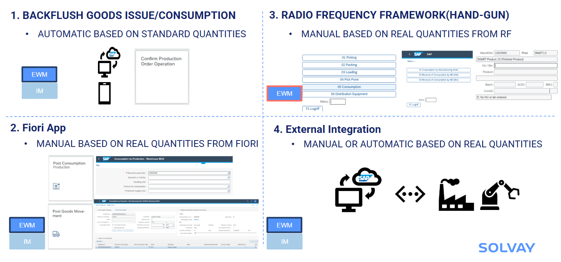
L3 Chemical Core Process Flow Diagram
Recap Process Order integration with EWM
Consumption for production

Slide 47
Workshop Agenda
Product and Production Master Data
Consumption for production

Slide 48
L3 Chemical Core Process Flow Diagram
Process Order integration with EWM
Consumption for production
Backflush consumption
Manual consumption
Consumption triggered by MES
Process order
confirmation
Perform Manual consumption per process order
MES or external system
Stock available in PSA
Stock available in PSA
Confirmation update in EWM
Goods movement update in S/4 HANA
Goods movement update in S/4 HANA
API
Stock available in PSA
1. /SCWM/MFG_CONSUME_ITEMS_EXT
2. /SCWM/MFG_REVERSE_ITEMS_EXT
3. /SCWM/MFG_CONSUME_HU_EXT
4. /SCWM/MFG_REVERSE_HU_EXT
5. /SCWM/MFG_READ_STOCK_EXT
6. /SCWM/MFG_STAGE_EXT
Auto consumption of components
Process order update
Process order
confirmation
EWM/IM
EWM
*Custom development
EWM/IM

Slide 49
L3 Chemical Core Process Flow Diagram
Process Order integration with EWM
Consumption for production
Backflush consumption
Manual consumption
Consumption triggered by MES
Process order
confirmation
Perform Manual consumption per process order
MES or external system
Stock available in PSA
Stock available in PSA
Confirmation update in EWM
Goods movement update in S/4 HANA
Goods movement update in S/4 HANA
API
Stock available in PSA
1. /SCWM/MFG_CONSUME_ITEMS_EXT
2. /SCWM/MFG_REVERSE_ITEMS_EXT
3. /SCWM/MFG_CONSUME_HU_EXT
4. /SCWM/MFG_REVERSE_HU_EXT
5. /SCWM/MFG_READ_STOCK_EXT
6. /SCWM/MFG_STAGE_EXT
Auto consumption of components
Process order update
Process order
confirmation
EWM/IM
EWM
*Custom development
EWM/IM

Slide 50
L3 Chemical Core Process Flow Diagram
Process Order integration with EWM
Consumption for production
RF/Fiori
Stock available in PSA
Goto path:
03-Outbound process
05-Consumption
01-Consumption by MO
App: Consumption for production
Process order update
Enter process order number
Goods movement(261) update in process order
Scan/Enter the HU/Prod
Scan/Enter the qty to be consumed(Full/partial)-Next
Consumption posted

Slide 51
L4 Documentation & Actions
FIT/GAPs:
N° | Fit/GAP | Description
1
Action:
N° | Description | Owner | Due Date | Next steps

Slide 52
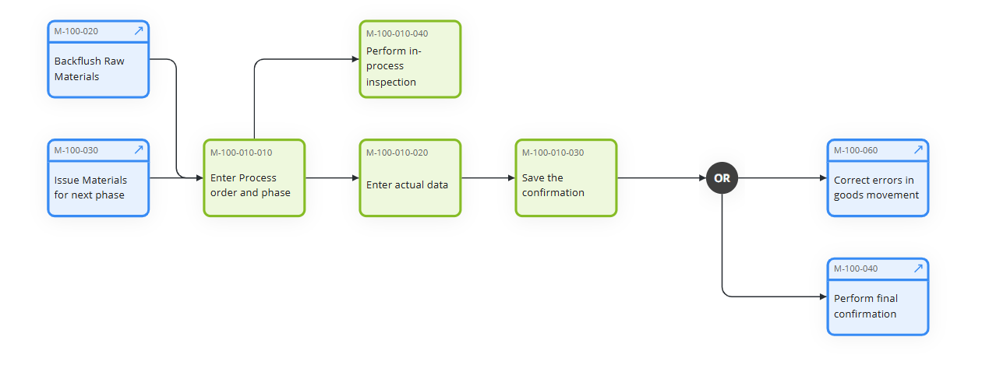
Confirm Process Order Operation/Phase - M-100-010
This process involves confirming the completion of specific operations or phases within a process order. It includes recording the actual time taken, quantities produced, and any deviations from the planned activities. It is used to monitor the progress of process orders. Using order confirmation, we can automatically issue goods (backflushing).

Slide 53
Confirm Process Order Operation/Phase
Enter Order & Phase details & then click on Goods Movement

Slide 54
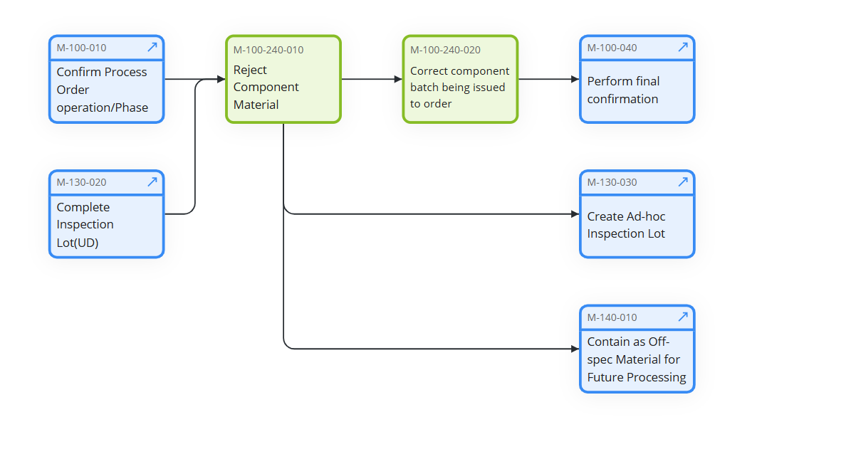
Reject Component - M-100-240
This process involves rejecting the component materials. This ensures that the production process doesn’t consume components which are not required.

Slide 55
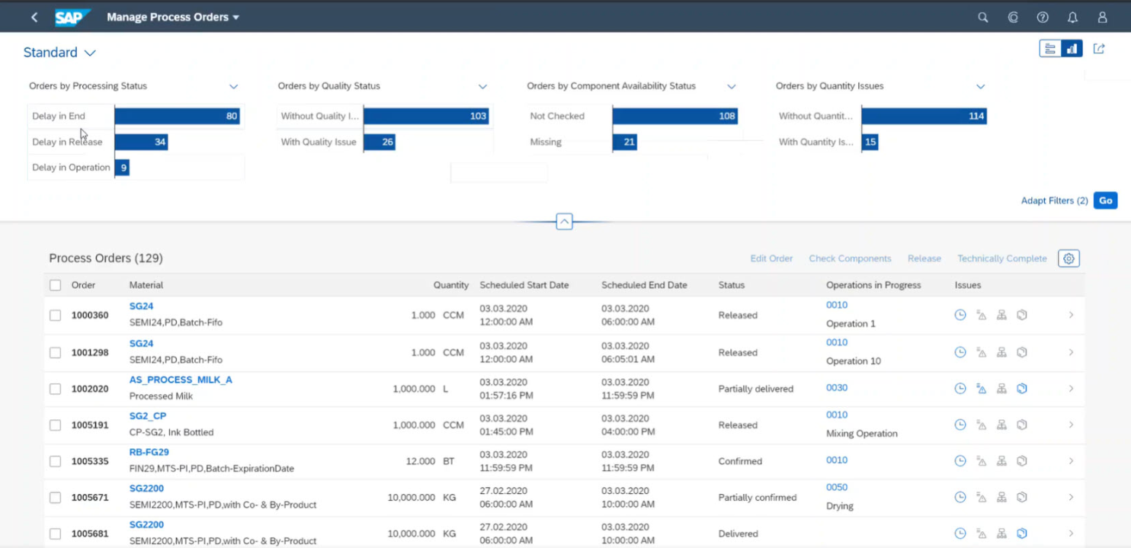
Illustration to Reject Components
Switch to Search

Slide 56
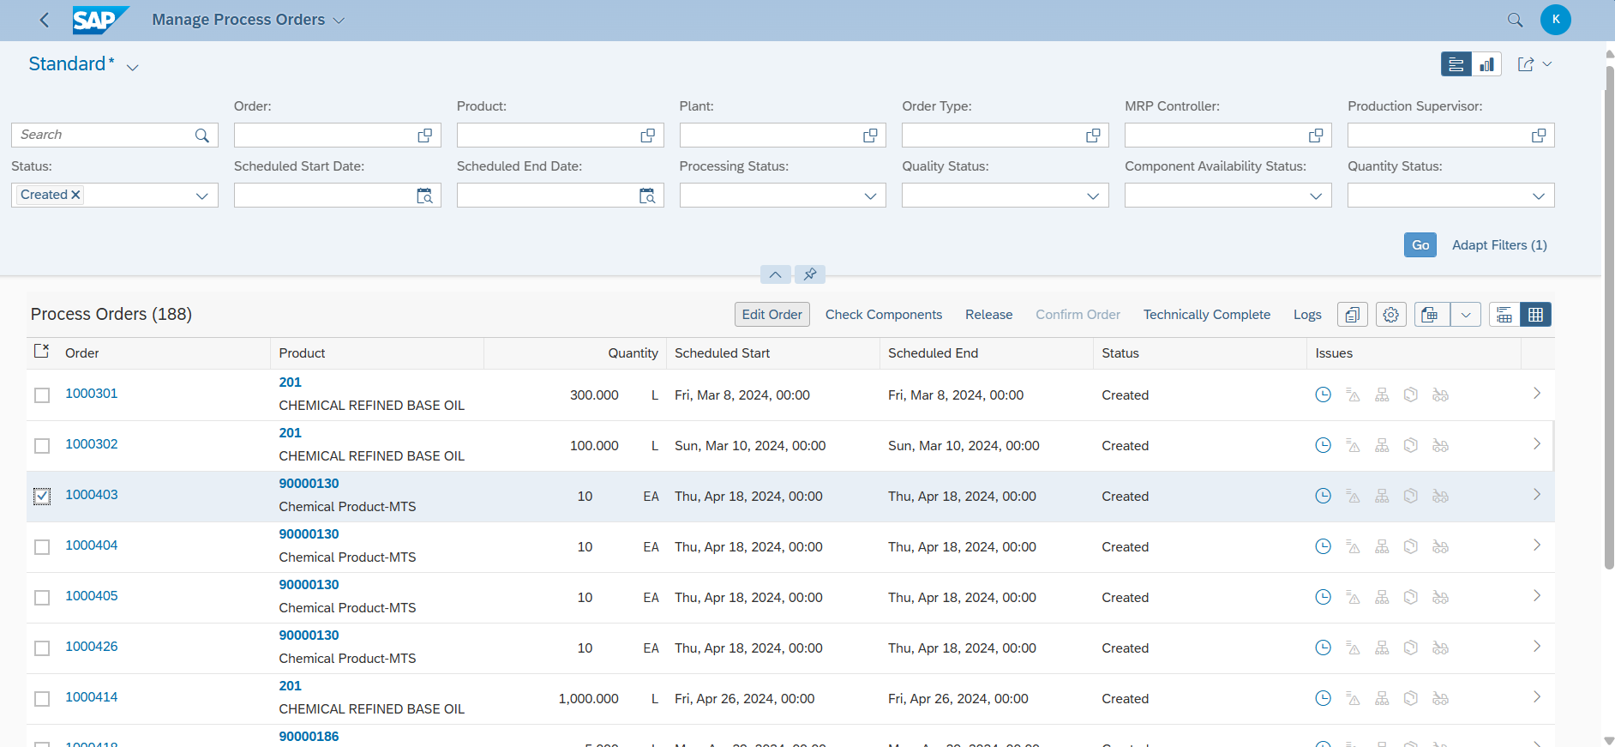
Illustration to Reject Components

Slide 57
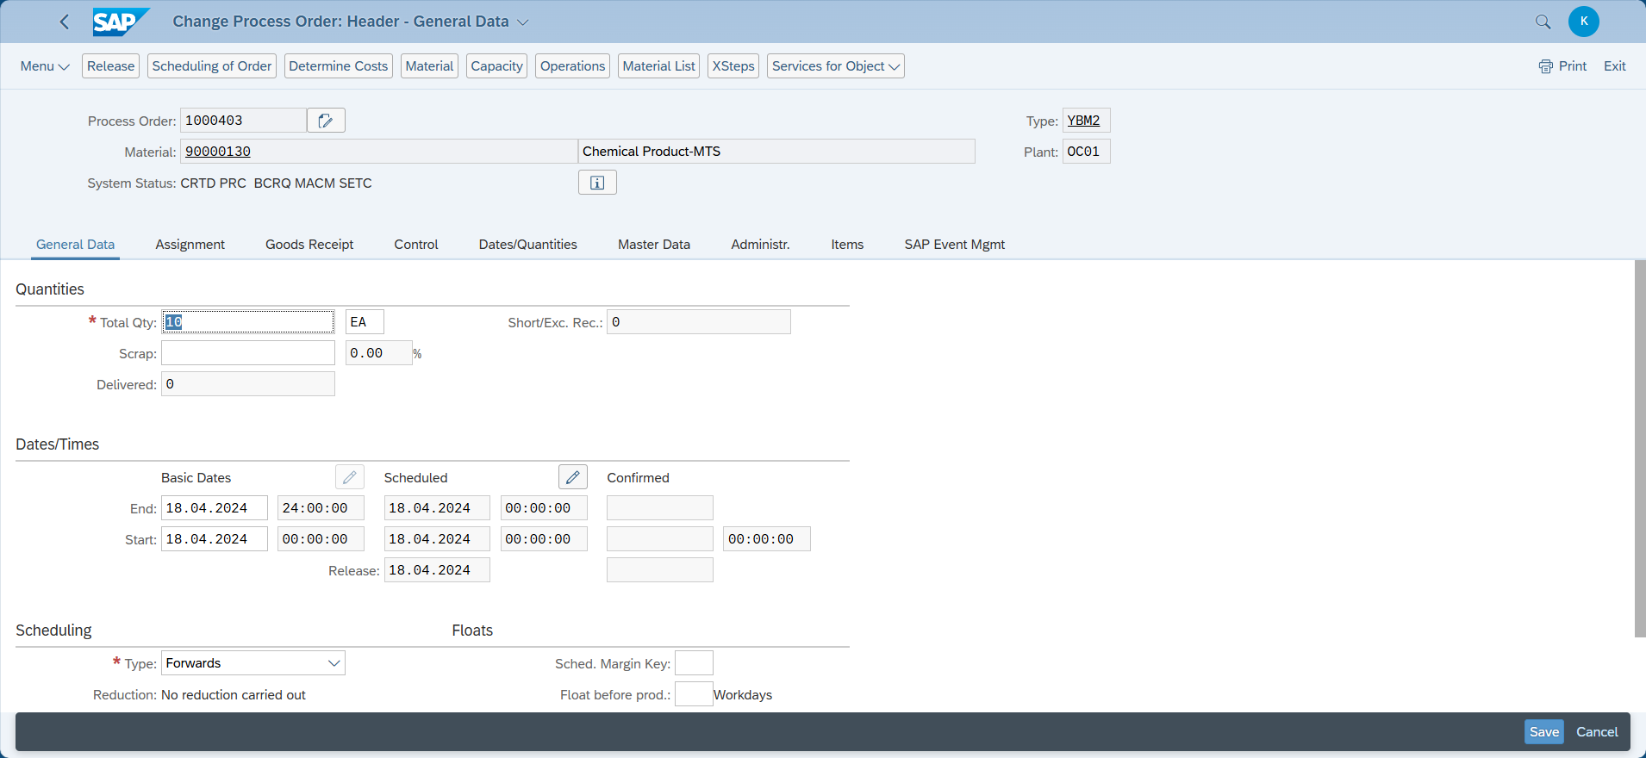
Illustration to Reject Components

Slide 58
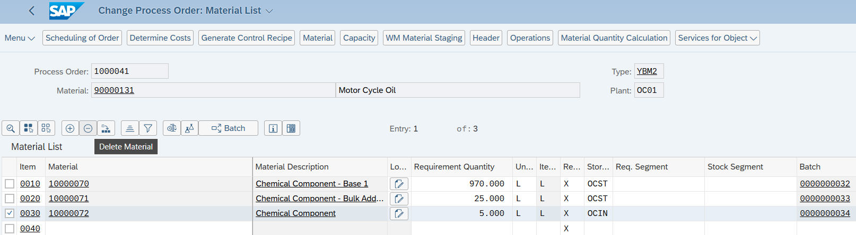
Illustration to Reject Component via Manage Process Order App
Select the material check box and click on Delete Material button

Slide 59
Workshop Agenda
Manufacturing Execution in SAP Packaged Process Orders and EWM Production Integration
Process Order creation and release
Staging for production with EWM
Manage BOM inventory
Execution of operations plan
Production receipt of bulk/Production receipt of packed product
Material quantities reconciliation
Production receipt of packed product
Defective production management
System Demo

Slide 60
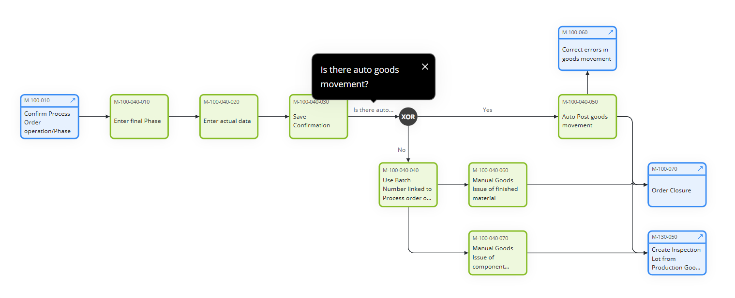
Perform Final Confirmation - M-100-040
This process involves performing final confirmation after production based on the batch number from the production order or automatically.

Slide 61
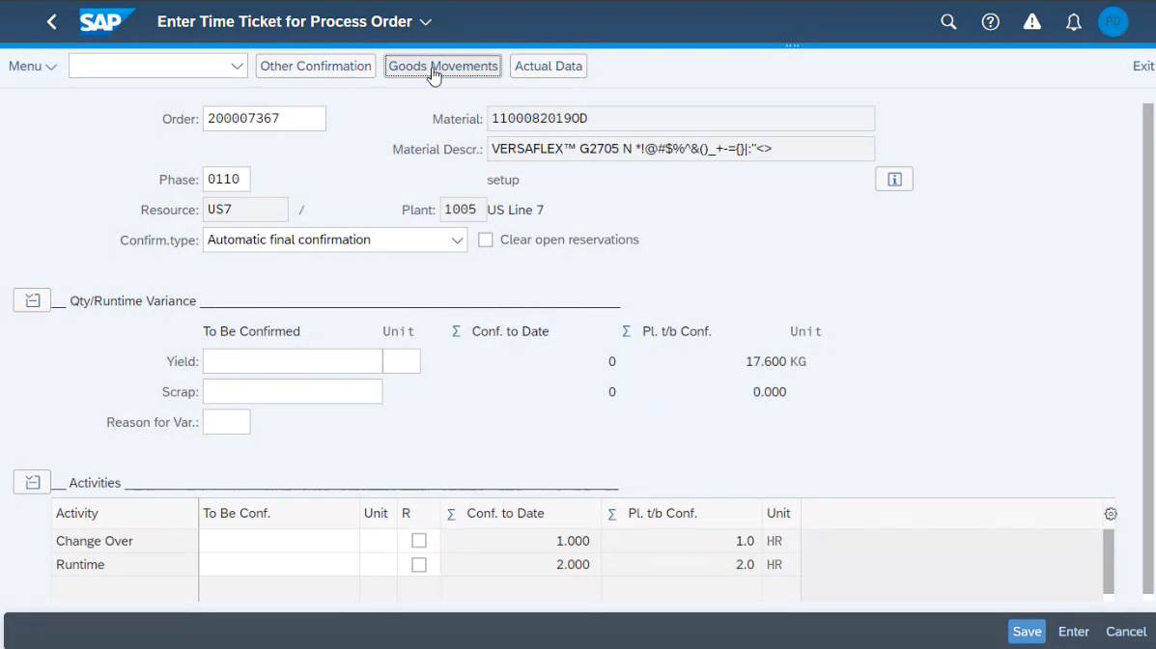
Illustration to Perform Final Confirmation via Confirm Process Order Phase
Enter Order details then click on Goods Movement

Slide 62
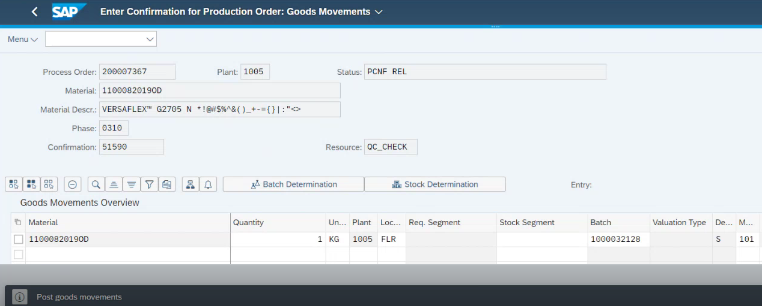
Illustration to Perform Final Confirmation via Confirm Process Order Phase
Material Number, Batch, Movement Type, Warehouse details are auto populated.
Enter Quantity, UoM, Receiving Storage Location, etc. as required, then click on Post.
Success message will be displayed on bottom right corner after posting the goods movement

Slide 63
Workshop Agenda
Manufacturing Execution in SAP Packaged Process Orders and EWM Production Integration
Process Order creation and release
Staging for production with EWM
Manage BOM inventory
Execution of operations plan
Production receipt of bulk/Production receipt of packed product
Material quantities reconciliation
Production receipt of packed product
Defective production management
System Demo

Slide 64
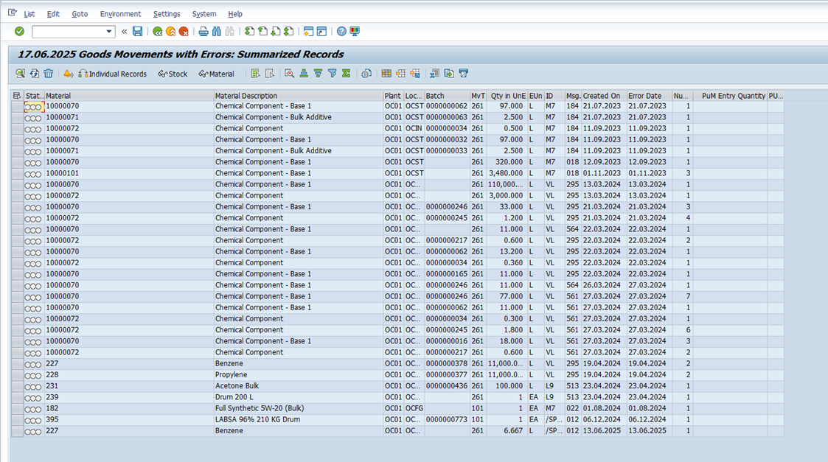
Illustration to COGI Errors -
Postprocessing of Error Records from Automatic Goods Movements
COGI in SAP is used to manage and correct errors from failed automatic goods movements during production, such as backflushing. When a posting fails, the error is logged in COGI, allowing users to review, fix, and reprocess the movement. This ensures production and inventory data remain accurate.

Slide 65
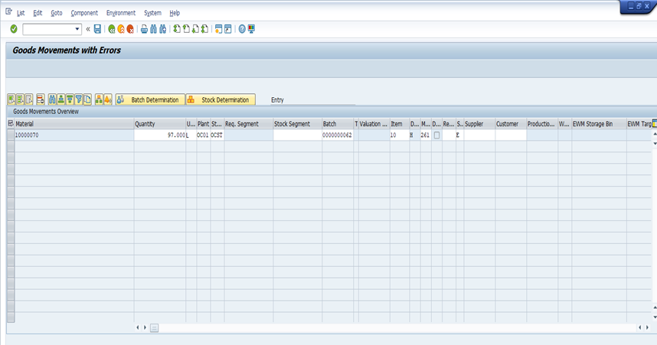
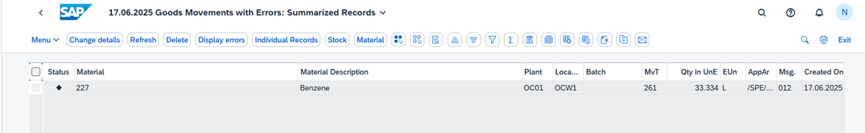
Illustration to COGI Errors -
Postprocessing of Error Records from Automatic Goods Movements
1.Access COGI
2.View Error List.
3.Analyze Error Details.
4.Correct the Error.
5.Reprocess the error.

Slide 66
Workshop Agenda
Manufacturing Execution in SAP Packaged Process Orders and EWM Production Integration
Process Order creation and release
Staging for production with EWM
Manage BOM inventory
Execution of operations plan
Production receipt of bulk/Production receipt of packed product
Material quantities reconciliation
Production receipt of packed product
Defective production management
System Demo

Slide 67
Objective of the Session
Approach for the workshop:
Quick recap on P2P integration with EWM models (Process manufacturing)
End to End process flow including staging, consumption and production receipt
Detailed discussion on each L4’s
Master data objects : Production supply area, Control cycles, assignment of production supply area to warehouse bin
Bulk and Finished goods - Process manufacturing with EWM integration
Identify gaps in standard process

Slide 68
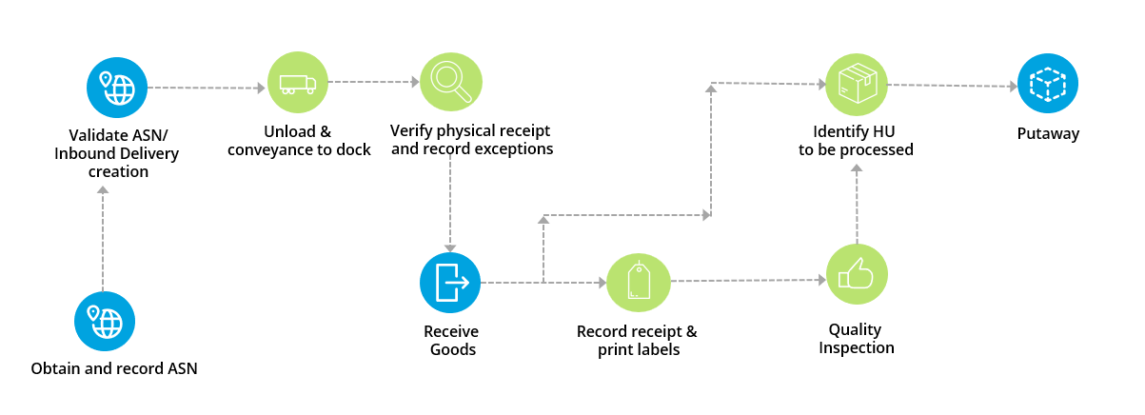










L3 Chemical Core Process Flow Diagram
Recap Process Order integration with EWM
Production receipt or goods receipt from production process flow
Automatic
Automatic
packing based on packaging specification
Automatic

Slide 69
Workshop Agenda
Product and Production Master Data
Goods receipt from production (or)
Production receipt

Slide 70
L3 Chemical Core Process Flow Diagram
Process Order integration with EWM
Production receipt or goods receipt from production
Auto Post Goods Receipt against Process Order
Manual Post Goods Receipt against Process Order
Process order
confirmation
Auto GR at operation confirmation
Process order
confirmation
Manual GR posting from MIGO against process order
Inbound delivery auto created
Inbound delivery auto created
Goods movement update in S/4 HANA
Goods movement update in S/4 HANA
Inbound delivery in EWM against process order
Packing in Handling units and labels
Inbound delivery in EWM against process order
Packing in Handling units and labels
Post goods receipt
Post goods receipt
Quality management after receipt
Putaway execution
Putaway location determination
Quality management after receipt
Putaway execution
Putaway location determination

Slide 71
L3 Chemical Core Process Flow Diagram
Process Order integration with EWM
Production receipt or goods receipt from production
Auto Post Goods Receipt against Process Order
Manual Post Goods Receipt against Process Order
Process order
confirmation
Auto GR at operation confirmation
Process order
confirmation
Manual GR posting from MIGO against process order
Inbound delivery auto created
Inbound delivery auto created
Goods movement update in S/4 HANA
Goods movement update in S/4 HANA
Inbound delivery in EWM against process order
Packing in Handling units and labels
Inbound delivery in EWM against process order
Packing in Handling units and labels
Record exceptions & Post goods receipt
Record exceptions & Post goods receipt
Quality management after receipt
Putaway execution
Putaway location determination
Quality management after receipt
Putaway execution
Putaway location determination

Slide 72
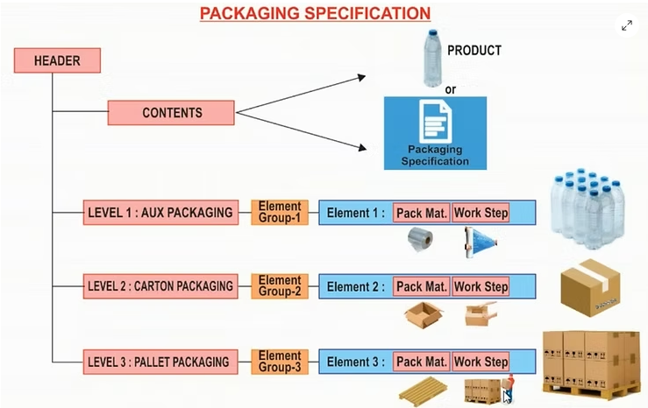
L3 Chemical Core Process Flow Diagram
Process Order integration with EWM
Packing in Handling units using packaging specification Automatic packing
A packaging specification is master data. The packaging specification defines all the necessary packing levels for a product in order, for example, to put away or transport the product.
For a product, a packaging specification mainly describes in which quantities you can pack the product into which packaging materials in which sequence.

Slide 73
L4 Documentation & Actions
FIT/GAPs:
N° | Fit/GAP | Description
1
Action:
N° | Description | Owner | Due Date | Next steps

Slide 74
L3 Chemical Core Process Flow Diagram
Process Order integration with EWM
Production receipt or goods receipt from production
Auto Post Goods Receipt against Process Order
Manual Post Goods Receipt against Process Order
Process order
confirmation
Auto GR at operation confirmation
Process order
confirmation
Manual GR posting from MIGO against process order
Inbound delivery auto created
Inbound delivery auto created
Goods movement update in S/4 HANA
Goods movement update in S/4 HANA
Inbound delivery in EWM against process order
Packing in Handling units and labels
Inbound delivery in EWM against process order
Packing in Handling units and labels
Record exceptions & Post goods receipt
Record exceptions & Post goods receipt
Quality management after receipt
Putaway execution
Putaway location determination
Quality management after receipt
Putaway execution
Putaway location determination

Slide 75
L3 Chemical Core Process Flow Diagram
Process Order integration with EWM
Records exception & post goods receipt
EDI/Manual
Update Inbound delivery quantity
Notify production facility of the discrepancy
Yes
If required, Physical receipt and records exceptions
Damaged/Missing?
Verify or correct packing list
No
Determine quality requirements
Receive goods
Process order update
Determine Putaway requirements
Goods movement(101) update

Slide 76
L3 Chemical Core Process Flow Diagram
Process Order integration with EWM
Records exception & post goods receipt
EDI/Manual
Update Inbound delivery quantity
Notify production facility of the discrepancy
Yes
If required, Physical receipt and records exceptions
Damaged/Missing?
Verify or correct packing list
No
Determine quality requirements
Receive goods
Process order update
Determine Putaway requirements
Goods movement(101) update

Slide 77
L4 Documentation & Actions
FIT/GAPs:
N° | Fit/GAP | Description
1
Action:
N° | Description | Owner | Due Date | Next steps

Slide 78
L3 Chemical Core Process Flow Diagram
Process Order integration with EWM
Production receipt or goods receipt from production
Auto Post Goods Receipt against Process Order
Manual Post Goods Receipt against Process Order
Process order
confirmation
Auto GR at operation confirmation
Process order
confirmation
Manual GR posting from MIGO against process order
Inbound delivery auto created
Inbound delivery auto created
Goods movement update in S/4 HANA
Goods movement update in S/4 HANA
Inbound delivery in EWM against process order
Packing in Handling units and labels
Inbound delivery in EWM against process order
Packing in Handling units and labels
Record exceptions & Post goods receipt
Record exceptions & Post goods receipt
Quality management after receipt
Putaway execution
Putaway location determination
Quality management after receipt
Putaway execution
Putaway location determination

Slide 79
L3 Chemical Core Process Flow Diagram
Process Order integration with EWM
Putaway location determination
Quality requirements/Results
Putaway strategies/Rules
Primary location available?
Confirm work instruction to direct receipt qty to primary location
Creates putaway warehouse tasks to direct material to primary location
Yes
Identify Handling units to be processed
Post goods receipt
System creates a work instruction to direct the receipt qty to a primary location
No
Create work instruction to direct receipt qty to secondary or reserved location
Creates putaway warehouse tasks to direct material to secondary or reserved location

Slide 80
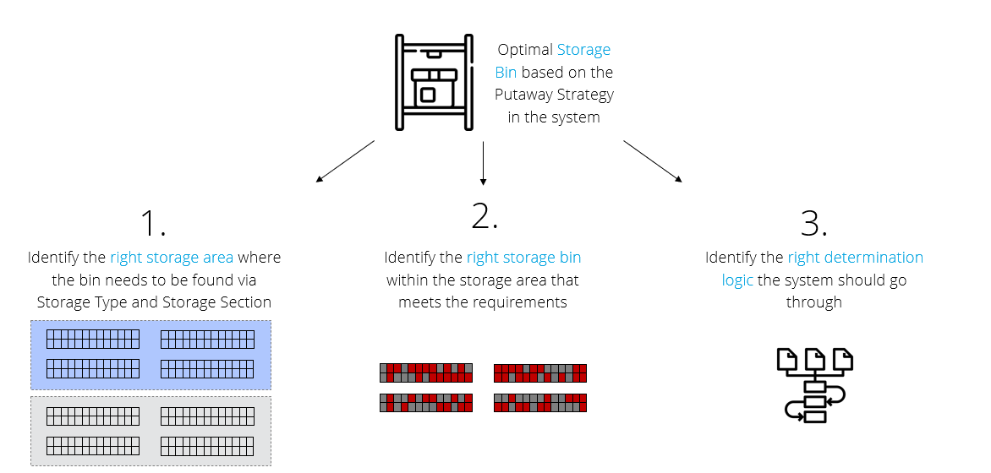
L3 Chemical Core Process Flow Diagram
Process Order integration with EWM
Stock placement strategies

Slide 81
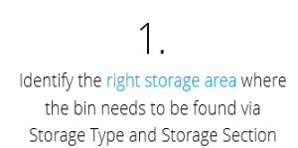
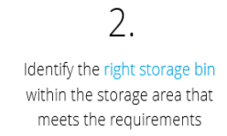
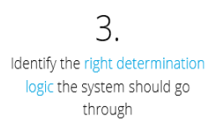
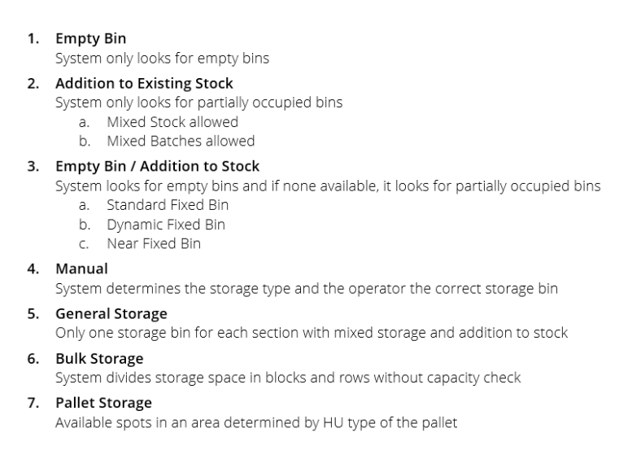


L3 Chemical Core Process Flow Diagram
Process Order integration with EWM
Stock placement strategies

Slide 82
L4 Documentation & Actions
FIT/GAPs:
N° | Fit/GAP | Description
1
Action:
N° | Description | Owner | Due Date | Next steps

Slide 83
L3 Chemical Core Process Flow Diagram
Process Order integration with EWM
Production receipt or goods receipt from production
Auto Post Goods Receipt against Process Order
Manual Post Goods Receipt against Process Order
Process order
confirmation
Auto GR at operation confirmation
Process order
confirmation
Manual GR posting from MIGO against process order
Inbound delivery auto created
Inbound delivery auto created
Goods movement update in S/4 HANA
Goods movement update in S/4 HANA
Inbound delivery in EWM against process order
Packing in Handling units and labels
Inbound delivery in EWM against process order
Packing in Handling units and labels
Record exceptions & Post goods receipt
Record exceptions & Post goods receipt
Quality management after receipt
Putaway execution
Putaway location determination
Quality management after receipt
Putaway execution
Putaway location determination

Slide 84
L3 Chemical Core Process Flow Diagram
Process Order integration with EWM
Putaway execution
Determine putaway requirements
Identify handling units to be processed
Review handling units warehouse tasks
Attach necessary documents to handling unit(If necessary)
Move Handling unit to the appropriate area as per the warehouse task
Update putaway completion in inbound delivery

Slide 85

L3 Chemical Core Process Flow Diagram
Process Order integration with EWM
Putaway execution

Slide 86
L4 Documentation & Actions
FIT/GAPs:
N° | Fit/GAP | Description
1
Action:
N° | Description | Owner | Due Date | Next steps

Slide 87
L3 Chemical Core Process Flow Diagram
Process Order integration with EWM
Production receipt or goods receipt from production
Auto Post Goods Receipt against Process Order
Manual Post Goods Receipt against Process Order
Process order
confirmation
Auto GR at operation confirmation
Process order
confirmation
Manual GR posting from MIGO against process order
Inbound delivery auto created
Inbound delivery auto created
Goods movement update in S/4 HANA
Goods movement update in S/4 HANA
Inbound delivery in EWM against process order
Packing in Handling units and labels
Inbound delivery in EWM against process order
Packing in Handling units and labels
Record exceptions & Post goods receipt
Record exceptions & Post goods receipt
Quality management after receipt
Putaway execution
Putaway location determination
Quality management after receipt
Putaway execution
Putaway location determination

Slide 88
L3 Chemical Core Process Flow Diagram
Process Order integration with EWM
Determine quality requirements
Create work instruction to direct HU to Quality hold area
Receive goods
Determine putaway requirements
Create work instruction to direct the portion of receipt quality hold area

Slide 89
L4 Documentation & Actions
FIT/GAPs:
N° | Fit/GAP | Description
1
Action:
N° | Description | Owner | Due Date | Next steps

Slide 90
L3 Chemical Core Process Flow Diagram
Process Order integration with EWM
Return to stock from production
Process order
TECO
Plan Return to Stock from Production
Excess Stock available in PSA
Execute movement back to Stock

Slide 91
L4 Documentation & Actions
FIT/GAPs:
N° | Fit/GAP | Description
1
Action:
N° | Description | Owner | Due Date | Next steps

Slide 92



L3 Chemical Core Process Flow Diagram
Process Order integration with EWM
Master data
Production supply area(PSA)
Control cycles
PSA assignment to PSA bin
You do not assign a storage bin to a production supply area (PSA) directly, instead you define the storage bin in which you want to stage a particular product or product group within a PSA.
Designated location on the shop floor where materials are staged for use in production.
The control cycle defines the relationship between the demand source and the supply source.

Slide 93
Workshop Agenda
Manufacturing Execution in SAP Packaged Process Orders and EWM Production Integration
Process Order creation and release
Staging for production with EWM
Manage BOM inventory
Execution of operations plan
Production receipt of bulk/Production receipt of packed product
Material quantities reconciliation
Production receipt of packed product
Defective production management
System Demo

Slide 94

Blend - M-140-120
The blend process in SAP PP-PI involves combining different materials to achieve the desired product specifications. This step ensures the quality and consistency of the final product.

Slide 95

Rework Material - M-140-030
The rework process in SAP PP-PI involves addressing off-spec materials by processing rework orders to bring them up to the required standards, ensuring minimal waste and optimized resource usage.

Slide 96

Order Closure - M-100-070
This process involves recording the completion of all production activities associated with a process order & marking it as Technically Complete. This denotes the end of production activities & transfers the order to Finance team for Final Closure after their audit.

Slide 97
Illustration to Technically Complete Orders
Switch to Search

Slide 98

Illustration to Technically Complete Orders
Enter required filters and search for orders.
Select the orders and click on Technically Complete.

Slide 99


X Sheets illustration
X Sheets are modern, web-based electronic work instructions in SAP S/4HANA for process industries. They provide an intuitive, mobile-friendly interface for operators to manage and record production activities, offering greater usability and integration than traditional PI Sheets.​

Slide 100
Site Visit Inputs – Exception Processes
    Inputs from Site Visits:
MCG Entity | Short Description | Detailed Description
    Any site-specific
    exception processes?

Slide 101
Workshop Agenda
Manufacturing Execution in SAP Packaged Process Orders and EWM Production Integration
Process Order creation and release
Staging for production with EWM
Manage BOM inventory
Execution of operations plan
Production receipt of bulk/Production receipt of packed product
Material quantities reconciliation
Production receipt of packed product
Defective production management
System Demo

Slide 102
System Demo
1. Convert Planned Order to Process Order
2. Create and Manage Process Orders
3. Release Process Order
4. Stage and Issue Materials
5. Production Execution
6. Confirm Process Order
7. Post Goods Receipt
8. Order Closure

Slide 103
Workshop Agenda
Product and Production Master Data
Staging for production

Slide 104
L3 Chemical Core Process Flow Diagram
Process Order integration with EWM
Staging for production
Automatic
Process order release
Staging Request to EWM
Production material request
Plan stage for production
Execute production staging
Note & record exceptions
Stock moved to PSA

Slide 105
L3 Chemical Core Process Flow Diagram
Process Order integration with EWM
Staging for production
Automatic
Process order release
Staging Request to EWM
Production material request
Plan stage for production
Execute production staging
Note & record exceptions
Stock moved to PSA

Slide 106
L3 Chemical Core Process Flow Diagram
Process Order integration with EWM
Plan stage for production
Production material request
Execute staging for production manual or automatic(via BG job)
Staging warehouse order created
Stock movement rules
Single order staging
Cross order staging
Validate Staging warehouse order
Generate pick list
Execute production staging

Slide 107
L4 Documentation & Actions
FIT/GAPs:
N° | Fit/GAP | Description
1
Action:
N° | Description | Owner | Due Date | Next steps

Slide 108
Workshop Agenda
Product and Production Master Data
Staging for production

Slide 109
L3 Chemical Core Process Flow Diagram
Process Order integration with EWM
Staging for production
Automatic
Process order release
Staging Request to EWM
Production material request
Plan stage for production
Execute production staging
Note & record exceptions
Stock moved to PSA

Slide 110
L3 Chemical Core Process Flow Diagram
Process Order integration with EWM
Staging for production
Automatic
Process order release
Staging Request to EWM
Production material request
Plan stage for production
Execute production staging
Note & record exceptions
Stock moved to PSA

Slide 111
L3 Chemical Core Process Flow Diagram
Process Order integration with EWM
Plan stage for production
Production material request
Execute staging for production manual or automatic(via BG job)
Staging warehouse order created
Stock movement rules
Single order staging
Cross order staging
Validate Staging warehouse order
Generate pick list
Execute production staging

Slide 112
L4 Documentation & Actions
FIT/GAPs:
N° | Fit/GAP | Description
1
Action:
N° | Description | Owner | Due Date | Next steps

Slide 113
L3 Chemical Core Process Flow Diagram
Process Order integration with EWM
Execute production staging
Automatic
Process order release
Staging Request to EWM
Production material request
Plan stage for production
Execute production staging
Note & record exceptions
Stock moved to PSA

Slide 114
L3 Chemical Core Process Flow Diagram
Process Order integration with EWM
Execute production staging
Generate pick list
Scan staging WO/Process order on RF
Scan source verification fields on RF
Scan destination verification fields on RF
Note & Record exceptions
Stock moved from Source bin to destination(PSA)

Slide 115
L4 Documentation & Actions
FIT/GAPs:
N° | Fit/GAP | Description
1
Action:
N° | Description | Owner | Due Date | Next steps

Slide 116
L3 Chemical Core Process Flow Diagram
Process Order integration with EWM
Staging for production
Automatic
Process order release
Staging Request to EWM
Production material request
Plan stage for production
Execute production staging
Note & record exceptions
Stock moved to PSA

Slide 117
L3 Chemical Core Process Flow Diagram
Process Order integration with EWM
Record and manage exception
Yes
Perform pick denial
Adjust pick qty using exception codes
Any discrepancy with bin/stock?
Alternate stock exists?
Perform physical picking
No
Yes
Staging cannot be proceeded
No
Pick the required stock from system suggested source location
Move the stock to the system suggested destination
PSA

Slide 118
L4 Documentation & Actions
FIT/GAPs:
N° | Fit/GAP | Description
1
Action:
N° | Description | Owner | Due Date | Next steps

Slide 119
Workshop Agenda
Product and Production Master Data
Consumption for production

Slide 120
L3 Chemical Core Process Flow Diagram
Recap Process Order integration with EWM
Consumption for production

Slide 121
L3 Chemical Core Process Flow Diagram
Process Order integration with EWM
Consumption for production
Backflush consumption
Manual consumption
Consumption triggered by MES
Process order
confirmation
Perform Manual consumption per process order
MES or external system
Stock available in PSA
Stock available in PSA
Confirmation update in EWM
Goods movement update in S/4 HANA
Goods movement update in S/4 HANA
API
Stock available in PSA
1. /SCWM/MFG_CONSUME_ITEMS_EXT
2. /SCWM/MFG_REVERSE_ITEMS_EXT
3. /SCWM/MFG_CONSUME_HU_EXT
4. /SCWM/MFG_REVERSE_HU_EXT
5. /SCWM/MFG_READ_STOCK_EXT
6. /SCWM/MFG_STAGE_EXT
Auto consumption of components
Process order update
Process order
confirmation
EWM/IM
EWM
*Custom development
EWM/IM

Slide 122
L3 Chemical Core Process Flow Diagram
Process Order integration with EWM
Consumption for production
Backflush consumption
Manual consumption
Consumption triggered by MES
Process order
confirmation
Perform Manual consumption per process order
MES or external system
Stock available in PSA
Stock available in PSA
Confirmation update in EWM
Goods movement update in S/4 HANA
Goods movement update in S/4 HANA
API
Stock available in PSA
1. /SCWM/MFG_CONSUME_ITEMS_EXT
2. /SCWM/MFG_REVERSE_ITEMS_EXT
3. /SCWM/MFG_CONSUME_HU_EXT
4. /SCWM/MFG_REVERSE_HU_EXT
5. /SCWM/MFG_READ_STOCK_EXT
6. /SCWM/MFG_STAGE_EXT
Auto consumption of components
Process order update
Process order
confirmation
EWM/IM
EWM
*Custom development
EWM/IM

Slide 123
L3 Chemical Core Process Flow Diagram
Process Order integration with EWM
Consumption for production
RF/Fiori
Stock available in PSA
Goto path:
03-Outbound process
05-Consumption
01-Consumption by MO
App: Consumption for production
Process order update
Enter process order number
Goods movement(261) update in process order
Scan/Enter the HU/Prod
Scan/Enter the qty to be consumed(Full/partial)-Next
Consumption posted

Slide 124
L4 Documentation & Actions
FIT/GAPs:
N° | Fit/GAP | Description
1
Action:
N° | Description | Owner | Due Date | Next steps

Slide 125
Workshop Agenda
Product and Production Master Data
Goods receipt from production (or)
Production receipt

Slide 126
L3 Chemical Core Process Flow Diagram
Recap Process Order integration with EWM
Production receipt or goods receipt from production process flow
Automatic
Automatic
packing based on packaging specification
Automatic

Slide 127
L3 Chemical Core Process Flow Diagram
Process Order integration with EWM
Production receipt or goods receipt from production
Auto Post Goods Receipt against Process Order
Manual Post Goods Receipt against Process Order
Process order
confirmation
Auto GR at operation confirmation
Process order
confirmation
Manual GR posting from MIGO against process order
Inbound delivery auto created
Inbound delivery auto created
Goods movement update in S/4 HANA
Goods movement update in S/4 HANA
Inbound delivery in EWM against process order
Packing in Handling units and labels
Inbound delivery in EWM against process order
Packing in Handling units and labels
Post goods receipt
Post goods receipt
Quality management after receipt
Putaway execution
Putaway location determination
Quality management after receipt
Putaway execution
Putaway location determination

Slide 128
Workshop Agenda
Product and Production Master Data
Goods receipt from production (or)
Production receipt

Slide 129
L3 Chemical Core Process Flow Diagram
Recap Process Order integration with EWM
Production receipt or goods receipt from production process flow
Automatic
Automatic
packing based on packaging specification
Automatic

Slide 130
L3 Chemical Core Process Flow Diagram
Process Order integration with EWM
Production receipt or goods receipt from production
Auto Post Goods Receipt against Process Order
Manual Post Goods Receipt against Process Order
Process order
confirmation
Auto GR at operation confirmation
Process order
confirmation
Manual GR posting from MIGO against process order
Inbound delivery auto created
Inbound delivery auto created
Goods movement update in S/4 HANA
Goods movement update in S/4 HANA
Inbound delivery in EWM against process order
Packing in Handling units and labels
Inbound delivery in EWM against process order
Packing in Handling units and labels
Post goods receipt
Post goods receipt
Quality management after receipt
Putaway execution
Putaway location determination
Quality management after receipt
Putaway execution
Putaway location determination

Slide 131
L3 Chemical Core Process Flow Diagram
Process Order integration with EWM
Production receipt or goods receipt from production
Auto Post Goods Receipt against Process Order
Manual Post Goods Receipt against Process Order
Process order
confirmation
Auto GR at operation confirmation
Process order
confirmation
Manual GR posting from MIGO against process order
Inbound delivery auto created
Inbound delivery auto created
Goods movement update in S/4 HANA
Goods movement update in S/4 HANA
Inbound delivery in EWM against process order
Packing in Handling units and labels
Inbound delivery in EWM against process order
Packing in Handling units and labels
Record exceptions & Post goods receipt
Record exceptions & Post goods receipt
Quality management after receipt
Putaway execution
Putaway location determination
Quality management after receipt
Putaway execution
Putaway location determination

Slide 132
L3 Chemical Core Process Flow Diagram
Process Order integration with EWM
Packing in Handling units using packaging specification Automatic packing
A packaging specification is master data. The packaging specification defines all the necessary packing levels for a product in order, for example, to put away or transport the product.
For a product, a packaging specification mainly describes in which quantities you can pack the product into which packaging materials in which sequence.

Slide 133
L4 Documentation & Actions
FIT/GAPs:
N° | Fit/GAP | Description
1
Action:
N° | Description | Owner | Due Date | Next steps

Slide 134
L3 Chemical Core Process Flow Diagram
Process Order integration with EWM
Production receipt or goods receipt from production
Auto Post Goods Receipt against Process Order
Manual Post Goods Receipt against Process Order
Process order
confirmation
Auto GR at operation confirmation
Process order
confirmation
Manual GR posting from MIGO against process order
Inbound delivery auto created
Inbound delivery auto created
Goods movement update in S/4 HANA
Goods movement update in S/4 HANA
Inbound delivery in EWM against process order
Packing in Handling units and labels
Inbound delivery in EWM against process order
Packing in Handling units and labels
Record exceptions & Post goods receipt
Record exceptions & Post goods receipt
Quality management after receipt
Putaway execution
Putaway location determination
Quality management after receipt
Putaway execution
Putaway location determination

Slide 135
Workshop Agenda
Product and Production Master Data
Goods receipt from production (or)
Production receipt

Slide 136
L3 Chemical Core Process Flow Diagram
Recap Process Order integration with EWM
Production receipt or goods receipt from production process flow
Automatic
Automatic
packing based on packaging specification
Automatic

Slide 137
L3 Chemical Core Process Flow Diagram
Process Order integration with EWM
Production receipt or goods receipt from production
Auto Post Goods Receipt against Process Order
Manual Post Goods Receipt against Process Order
Process order
confirmation
Auto GR at operation confirmation
Process order
confirmation
Manual GR posting from MIGO against process order
Inbound delivery auto created
Inbound delivery auto created
Goods movement update in S/4 HANA
Goods movement update in S/4 HANA
Inbound delivery in EWM against process order
Packing in Handling units and labels
Inbound delivery in EWM against process order
Packing in Handling units and labels
Post goods receipt
Post goods receipt
Quality management after receipt
Putaway execution
Putaway location determination
Quality management after receipt
Putaway execution
Putaway location determination

Slide 138
L3 Chemical Core Process Flow Diagram
Process Order integration with EWM
Production receipt or goods receipt from production
Auto Post Goods Receipt against Process Order
Manual Post Goods Receipt against Process Order
Process order
confirmation
Auto GR at operation confirmation
Process order
confirmation
Manual GR posting from MIGO against process order
Inbound delivery auto created
Inbound delivery auto created
Goods movement update in S/4 HANA
Goods movement update in S/4 HANA
Inbound delivery in EWM against process order
Packing in Handling units and labels
Inbound delivery in EWM against process order
Packing in Handling units and labels
Record exceptions & Post goods receipt
Record exceptions & Post goods receipt
Quality management after receipt
Putaway execution
Putaway location determination
Quality management after receipt
Putaway execution
Putaway location determination

Slide 139
L3 Chemical Core Process Flow Diagram
Process Order integration with EWM
Packing in Handling units using packaging specification Automatic packing
A packaging specification is master data. The packaging specification defines all the necessary packing levels for a product in order, for example, to put away or transport the product.
For a product, a packaging specification mainly describes in which quantities you can pack the product into which packaging materials in which sequence.

Slide 140
L4 Documentation & Actions
FIT/GAPs:
N° | Fit/GAP | Description
1
Action:
N° | Description | Owner | Due Date | Next steps

Slide 141
L3 Chemical Core Process Flow Diagram
Process Order integration with EWM
Production receipt or goods receipt from production
Auto Post Goods Receipt against Process Order
Manual Post Goods Receipt against Process Order
Process order
confirmation
Auto GR at operation confirmation
Process order
confirmation
Manual GR posting from MIGO against process order
Inbound delivery auto created
Inbound delivery auto created
Goods movement update in S/4 HANA
Goods movement update in S/4 HANA
Inbound delivery in EWM against process order
Packing in Handling units and labels
Inbound delivery in EWM against process order
Packing in Handling units and labels
Record exceptions & Post goods receipt
Record exceptions & Post goods receipt
Quality management after receipt
Putaway execution
Putaway location determination
Quality management after receipt
Putaway execution
Putaway location determination

Slide 142
L3 Chemical Core Process Flow Diagram
Process Order integration with EWM
Records exception & post goods receipt
EDI/Manual
Update Inbound delivery quantity
Notify production facility of the discrepancy
Yes
If required, Physical receipt and records exceptions
Damaged/Missing?
Verify or correct packing list
No
Determine quality requirements
Receive goods
Process order update
Determine Putaway requirements
Goods movement(101) update

Slide 143
L3 Chemical Core Process Flow Diagram
Process Order integration with EWM
Records exception & post goods receipt
EDI/Manual
Update Inbound delivery quantity
Notify production facility of the discrepancy
Yes
If required, Physical receipt and records exceptions
Damaged/Missing?
Verify or correct packing list
No
Determine quality requirements
Receive goods
Process order update
Determine Putaway requirements
Goods movement(101) update

Slide 144
L4 Documentation & Actions
FIT/GAPs:
N° | Fit/GAP | Description
1
Action:
N° | Description | Owner | Due Date | Next steps

Slide 145
L3 Chemical Core Process Flow Diagram
Process Order integration with EWM
Production receipt or goods receipt from production
Auto Post Goods Receipt against Process Order
Manual Post Goods Receipt against Process Order
Process order
confirmation
Auto GR at operation confirmation
Process order
confirmation
Manual GR posting from MIGO against process order
Inbound delivery auto created
Inbound delivery auto created
Goods movement update in S/4 HANA
Goods movement update in S/4 HANA
Inbound delivery in EWM against process order
Packing in Handling units and labels
Inbound delivery in EWM against process order
Packing in Handling units and labels
Record exceptions & Post goods receipt
Record exceptions & Post goods receipt
Quality management after receipt
Putaway execution
Putaway location determination
Quality management after receipt
Putaway execution
Putaway location determination

Slide 146
L3 Chemical Core Process Flow Diagram
Process Order integration with EWM
Putaway location determination
Quality requirements/Results
Putaway strategies/Rules
Primary location available?
Confirm work instruction to direct receipt qty to primary location
Creates putaway warehouse tasks to direct material to primary location
Yes
Identify Handling units to be processed
Post goods receipt
System creates a work instruction to direct the receipt qty to a primary location
No
Create work instruction to direct receipt qty to secondary or reserved location
Creates putaway warehouse tasks to direct material to secondary or reserved location

Slide 147
L3 Chemical Core Process Flow Diagram
Process Order integration with EWM
Stock placement strategies

Slide 148
L3 Chemical Core Process Flow Diagram
Process Order integration with EWM
Stock placement strategies

Slide 149
L3 Chemical Core Process Flow Diagram
Process Order integration with EWM
Stock placement strategies

Slide 150
L4 Documentation & Actions
FIT/GAPs:
N° | Fit/GAP | Description
1
Action:
N° | Description | Owner | Due Date | Next steps

Slide 151
L3 Chemical Core Process Flow Diagram
Process Order integration with EWM
Production receipt or goods receipt from production
Auto Post Goods Receipt against Process Order
Manual Post Goods Receipt against Process Order
Process order
confirmation
Auto GR at operation confirmation
Process order
confirmation
Manual GR posting from MIGO against process order
Inbound delivery auto created
Inbound delivery auto created
Goods movement update in S/4 HANA
Goods movement update in S/4 HANA
Inbound delivery in EWM against process order
Packing in Handling units and labels
Inbound delivery in EWM against process order
Packing in Handling units and labels
Record exceptions & Post goods receipt
Record exceptions & Post goods receipt
Quality management after receipt
Putaway execution
Putaway location determination
Quality management after receipt
Putaway execution
Putaway location determination

Slide 152
L3 Chemical Core Process Flow Diagram
Process Order integration with EWM
Putaway execution
Determine putaway requirements
Identify handling units to be processed
Review handling units warehouse tasks
Attach necessary documents to handling unit(If necessary)
Move Handling unit to the appropriate area as per the warehouse task
Update putaway completion in inbound delivery

Slide 153
L3 Chemical Core Process Flow Diagram
Process Order integration with EWM
Putaway execution

Slide 154
L4 Documentation & Actions
FIT/GAPs:
N° | Fit/GAP | Description
1
Action:
N° | Description | Owner | Due Date | Next steps

Slide 155
L3 Chemical Core Process Flow Diagram
Process Order integration with EWM
Production receipt or goods receipt from production
Auto Post Goods Receipt against Process Order
Manual Post Goods Receipt against Process Order
Process order
confirmation
Auto GR at operation confirmation
Process order
confirmation
Manual GR posting from MIGO against process order
Inbound delivery auto created
Inbound delivery auto created
Goods movement update in S/4 HANA
Goods movement update in S/4 HANA
Inbound delivery in EWM against process order
Packing in Handling units and labels
Inbound delivery in EWM against process order
Packing in Handling units and labels
Record exceptions & Post goods receipt
Record exceptions & Post goods receipt
Quality management after receipt
Putaway execution
Putaway location determination
Quality management after receipt
Putaway execution
Putaway location determination

Slide 156
L3 Chemical Core Process Flow Diagram
Process Order integration with EWM
Determine quality requirements
Create work instruction to direct HU to Quality hold area
Receive goods
Determine putaway requirements
Create work instruction to direct the portion of receipt quality hold area

Slide 157
L4 Documentation & Actions
FIT/GAPs:
N° | Fit/GAP | Description
1
Action:
N° | Description | Owner | Due Date | Next steps

Slide 158
L3 Chemical Core Process Flow Diagram
Process Order integration with EWM
Return to stock from production
Process order
TECO
Plan Return to Stock from Production
Excess Stock available in PSA
Execute movement back to Stock

Slide 159
L4 Documentation & Actions
FIT/GAPs:
N° | Fit/GAP | Description
1
Action:
N° | Description | Owner | Due Date | Next steps

Slide 160
L3 Chemical Core Process Flow Diagram
Process Order integration with EWM
Master data
Production supply area(PSA)
Control cycles
PSA assignment to PSA bin
You do not assign a storage bin to a production supply area (PSA) directly, instead you define the storage bin in which you want to stage a particular product or product group within a PSA.
Designated location on the shop floor where materials are staged for use in production.
The control cycle defines the relationship between the demand source and the supply source.

Slide 161



Summary of Previous Discussion
Type | Previous discussion points
Key Design Decisions
Initial Gaps | /
Other | /

Slide 162
Action Items and Parking Lot
Action items
Parking lot Items
Please refer to the following document to find the action items:
Please refer to the following document to find the parking lot items:

Slide 163
Present related Business Requirements
Are there any Business Requirements we should keep in mind when discussing and designing processes within this topic?
Type of Business Requirements | Explanation

Slide 164


Thank you

